Slide 1

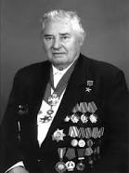

Optimization methods in inverse problems
Sergey Kabanikhin
Institute of Computational Mathematics
and Mathematical Geophysics, Novosibirsk
e-mail: kabanikhin@sscc.ru
15-th International Asian School-Seminar
«Optimization problems of complex systems»
August 26-30, 2019, Academgorodok, Novosibirsk, Russia

Slide 2
Content
Inverse and Ill-Posed Problems.
Thermoacoustics.
HIV and tuberculosis.
Geophysics.

Slide 3
Content
Inverse and Ill-Posed Problems.
Thermoacoustics.
HIV and tuberculosis.
Geophysics.

Slide 4
Считается, что правополушарные - это художники,
а левополушарные - математики.
Провели эксперименты: люди обследовались в функционально-магнитно-резонансном
томографе, и мозг математика демонстрировал схожую активность от созерцания
прекрасных картин и красиво выведенной теоремы.

Slide 5
Definitions
The problem A(q)=f is said to be well-posed, if
for every f from F there exists solution q from Q
the solution q is unique in Q
the solution q depends continuously on data f
The problem Aq=f is said to be ill-posed if at least one condition from 1. , 2. and 3. is not true.
The most interesting and practical inverse problems are usually ill-posed.

Slide 7
tuberculosis
tuberculosis

Slide 8
Content
Inverse and Ill-Posed Problems.
Thermoacoustics.
HIV and tuberculosis.
Geophysics.

Slide 9
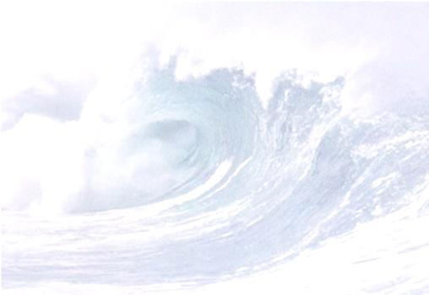
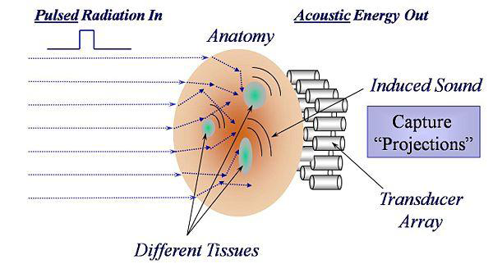

Physics: thermoacoustic problem
$c$ – velocity of propagation of acoustic pressure waves;
$α(x,y)$ – coefficient of absorption of electromagnetic radiation;
$β$ – coefficient of thermal expansion;
$c_{p}$ - specific heat at constant pressure.
The work frequency is 434 MHz.
Thermoacoustic problem is important in cancer detecting because the study of diseased tissue revealed that the mass fraction of water in them is significantly higher than in healthy tissues [1]. If the healthy tissue water content is about 65%, in infected it reaches 80%.

Slide 10
Expression for misfit function $J(q)$
Consider the inverse problems in the next forms:

Slide 11
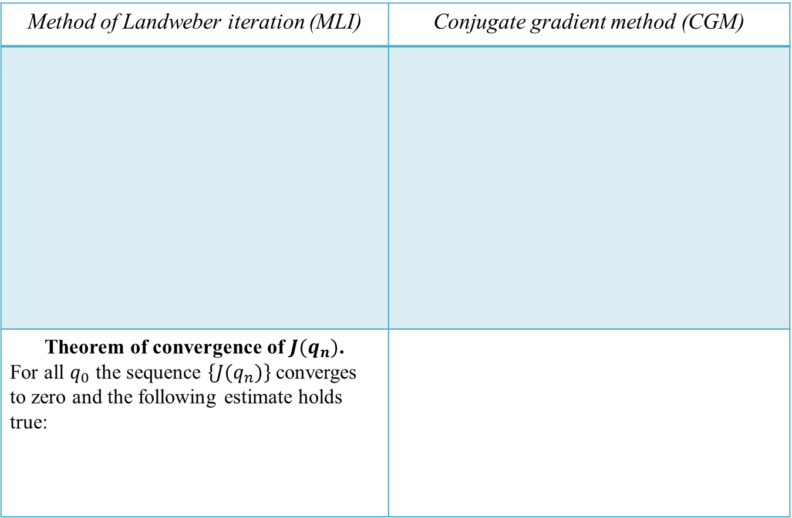
Method of Landweber iteration (MLI) and conjugate gradient method (CGM)
Method of Landweber iteration (MLI) | Conjugate gradient method (CGM)
Theorem of convergence of $J{(q}_{n})$. For all $q_{0}$ the sequence $\left\{J(q_{n})\right\}$ converges to zero and the following estimate holds true:
…

Slide 12
Gradients $J_{i}′(q)$ of the functionals $J_{i}(q)$, $i=1,2,3, c=1$
Inverse problem 1:
Inverse problem 2:
Inverse problem 3:

Slide 13
Gradient $J′q$ of the functional $J(q)$
Inverse problem 4:
Here satisfied the next problem :

Slide 14
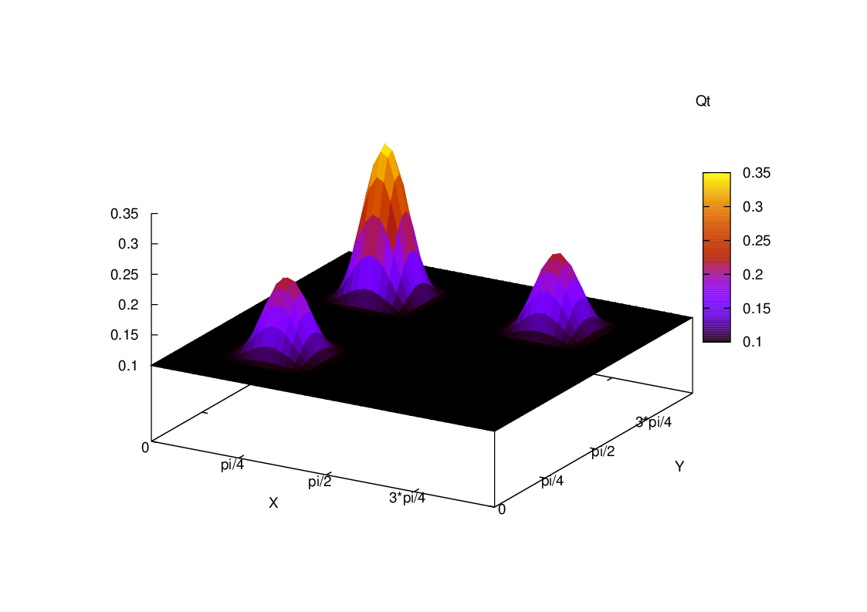


The first numerical experiment
(thermoacoustic problem)
$L_{1}=L_{2}=T=π$. Grid: $N_{x}=N_{y}=50, N_{t}=4800.$
Figure 1. Exact solution $q_{T_{1}}$

Slide 15
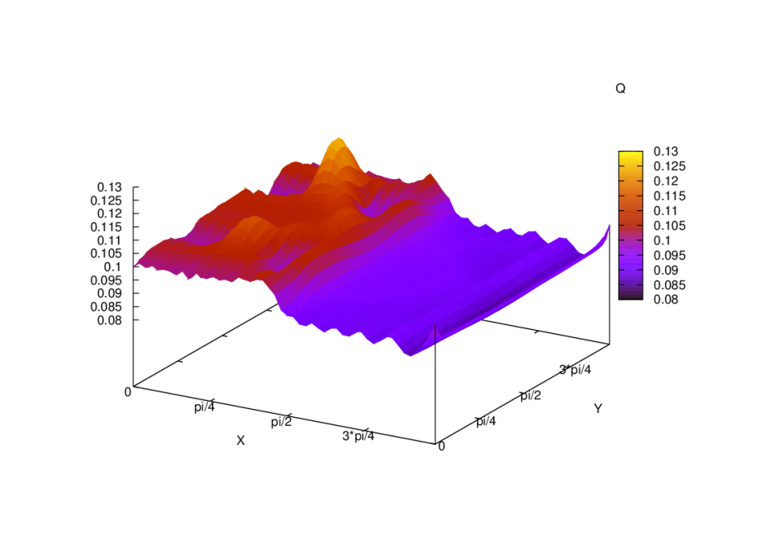

Method of Landweber iteration.
Inverse problem 1 (one measurement at $x=0$).
Five hundred iterations.
Figure 2. (left) the exact solution $q_{T_{1}}$, (right) the reconstruction solution $q_{n}$
We could reconstruct only one inclusion and a small image of the second one.
Note that we can “see” inclusions which are located near the surface of measurements.
And this anomalies are with some noise.
But we could not determine the third inclusion, which is in the shadow of the biggest inclusion.

Slide 16
Content
Inverse and Ill-Posed Problems.
Thermoacoustics.
HIV and tuberculosis.
Geophysics.

Slide 17
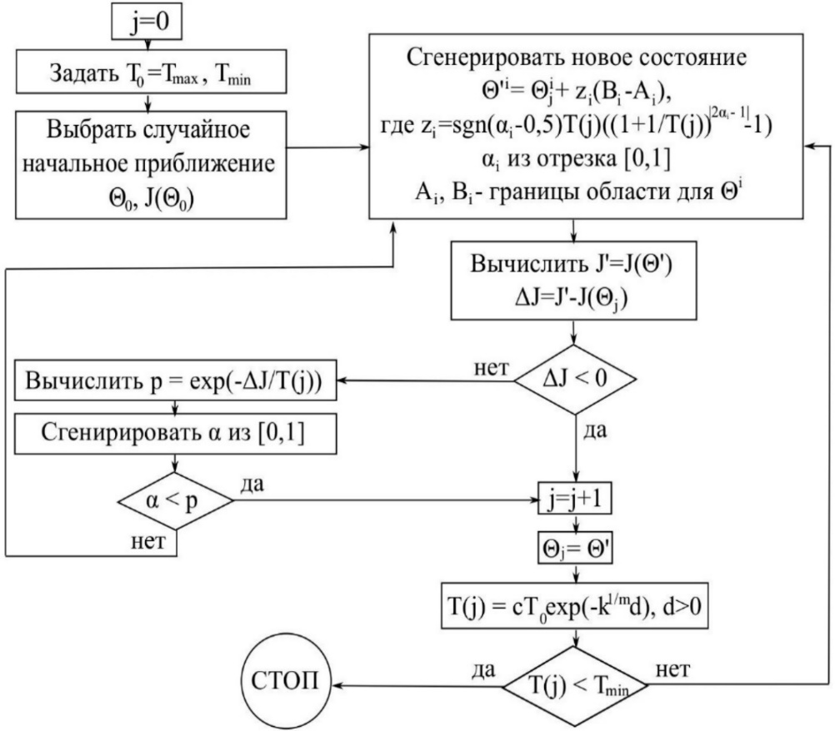
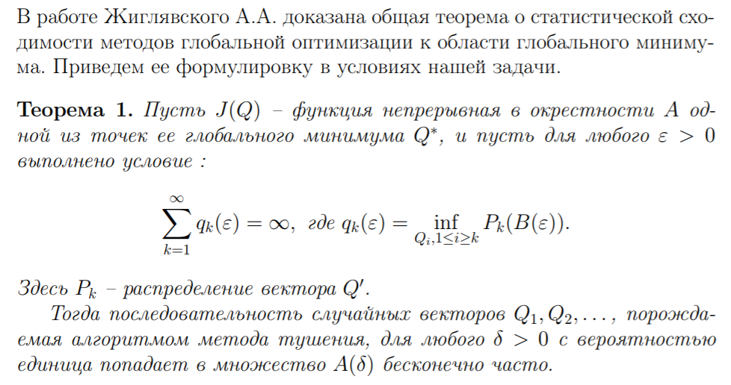
Метод имитации отжига:
Статистическая гарантия нахождения области глобального минимума:
А. Жиглявский, А. Жилинкас. Методы глобальной оптимизации. Москва, 2008 :
Р. Азенкотт. Процедура “отпуска”. Труды семинара Н. Бурбаки за 1988 год :
В статье показано, что выбор стратегии уменьшения T (температуры в методе отжига), обеспечивающей сходимость метода к глобальному оптимуму, напрямую зависит от постановки задачи минимизации и свойств ограничений в ней.

Slide 18
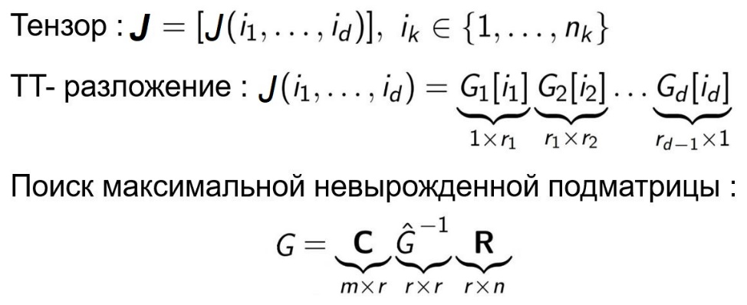
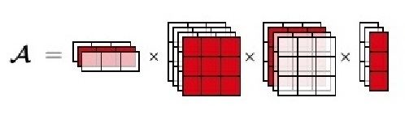
Метод тензорного разложения :
Замечания:
В данном виде предложен в статье :
I. V. Oseledets. Tensor-train decomposition. SIAM J. Sci. Comput. – 2011. –Vol. 33.
Pр. 2295–2317.
Метод неравномерных покрытий Ю. Г. Евтушенко.
В реализации метода использованы инструменты векторной алгебры, что позволяет выполнять вычисления параллельно.
Требует больших объемов памяти для вычислений.

Slide 19
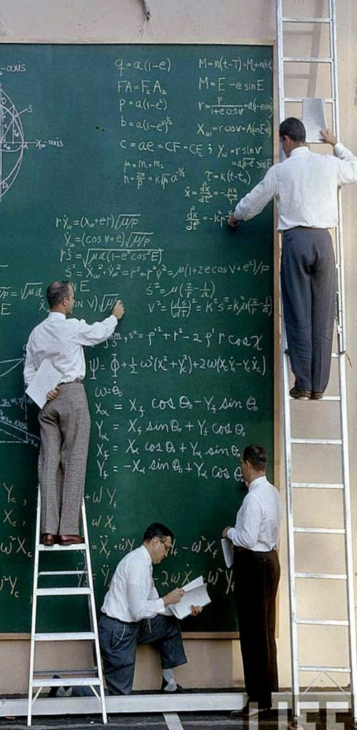
Brief history of mathematical modeling TB and HIV based on ODEs:
1962 H.T. Waaler. The first linear mathematical model of TB spread ;
1991 Stiblo. Dependence on the effectiveness of tuberculosis detection and treatment;
1996 Blower. Predicting effectiveness of TB control programs, exogenous super infection, delayed detection;
1997 West, Tompson. Modeling the impact of HIV on the spread of tuberculosis;
1997 Vynnycky, Fine. 1998 Dye. Murray. Global model of TB spread;
1999 Kirschner. 2000 Castillo-Chavez. Dynamics of coinfection with m. tuberculosis and HIV-1;
2002 Castillo-Chavez. Markers of disease evolution: the case of tuberculosis;
2003 Romanyukha. The spread of infection in a heterogeneous population;
2004 Adams, Banks. Optimal control approach for two parameter identification in mathematical model of HIV dynamics;
2007 Romanyukha, Avilov. A fundamental mathematical model of TB spread with treatment. “Rebuild" a model to real data;
2008 Sharomi, Podder, Gumel, Song. Mathematical analysis of the transmission dynamics of HIV/TB coinfection in the presence of treatment;
2009 Roeger, Feng, Castillo-Chavez. Modeling TB and HIV co-infections;
2009. Pertsev. Individual-oriented stochastic model of TB spread;
2014. Pertsev. Continuously discrete model of distribution and control of tuberculosis;
2015. Romanyukha. The distribution pattern of resistant strains of mycobacteria TB in a heterogeneous population.
2015 Bocharov. Numerical algorithm for finding an optimal treatment of HIV.

Slide 20
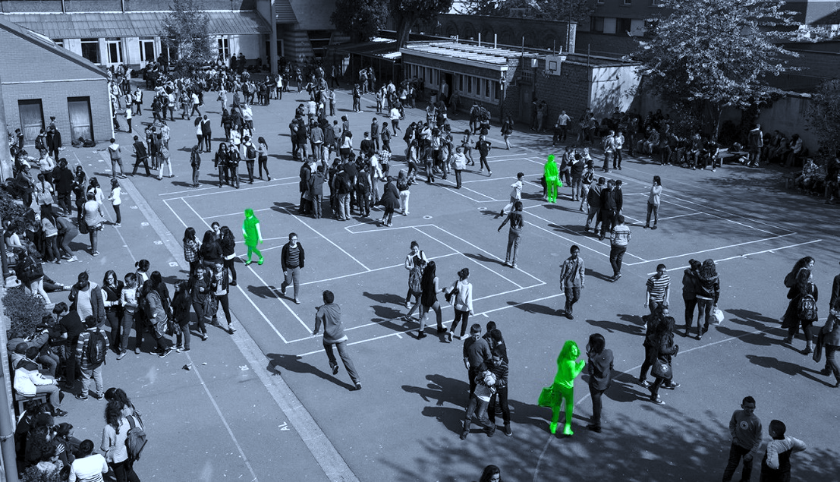
Modelling of epidemics transmission dynamics :
Epidemic
Data
Model
Prediction
1

Slide 21
Modelling of epidemics transmission dynamics :
Epidemic
Data
Model
Prediction
1

Slide 22
Modelling of epidemics transmission dynamics :
Epidemic
Data
Model
Prediction
1

Slide 23
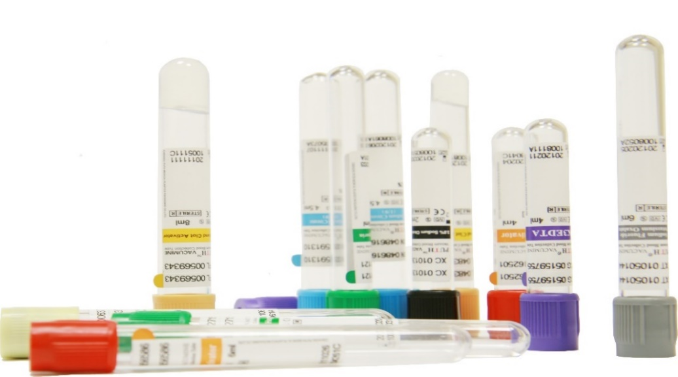
Parameter identification problem statement (inverse problem)
Use some statistical data at fixed time-points
Use initial statement
2

Slide 24

Parameter identification problem statement (inverse problem)
Use some statistical data at fixed time-points
Use initial statement
Refine the parameters described infection specifics, population, immune response
2

Slide 25

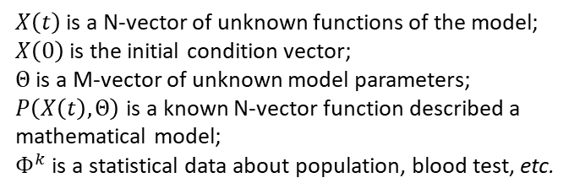
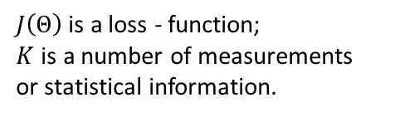
Parameter identification problem statement (inverse problem)
Use some statistical data at fixed time-points
Use initial statement
Refine the parameters described infection specifics, population, immune response
$X\left(t\right)$ is a N-vector of unknown functions of the model;
$X\left(0\right)$ is the initial condition vector;
$Θ$ is a M-vector of unknown model parameters;
$P\left(X\left(t\right), Θ\right)$ is a known N-vector function described a mathematical model;
$Φ^{k}$ is a statistical data about population, blood test, etc.
$J\left(Θ\right)$ is a loss - function;
$K$ is a number of measurements or statistical information.

Slide 26
Methods :
Analytical
Heuristic / statistical
3

Slide 27
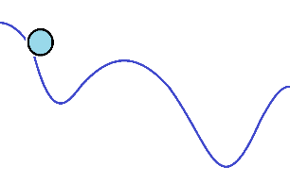
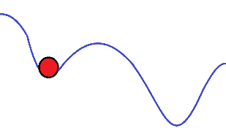
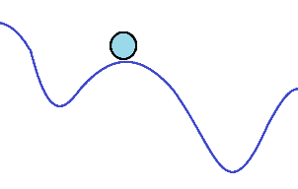
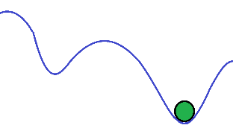
Methods :
Analytical
Heuristic / statistical :
Simulated annealing method
3

Slide 28
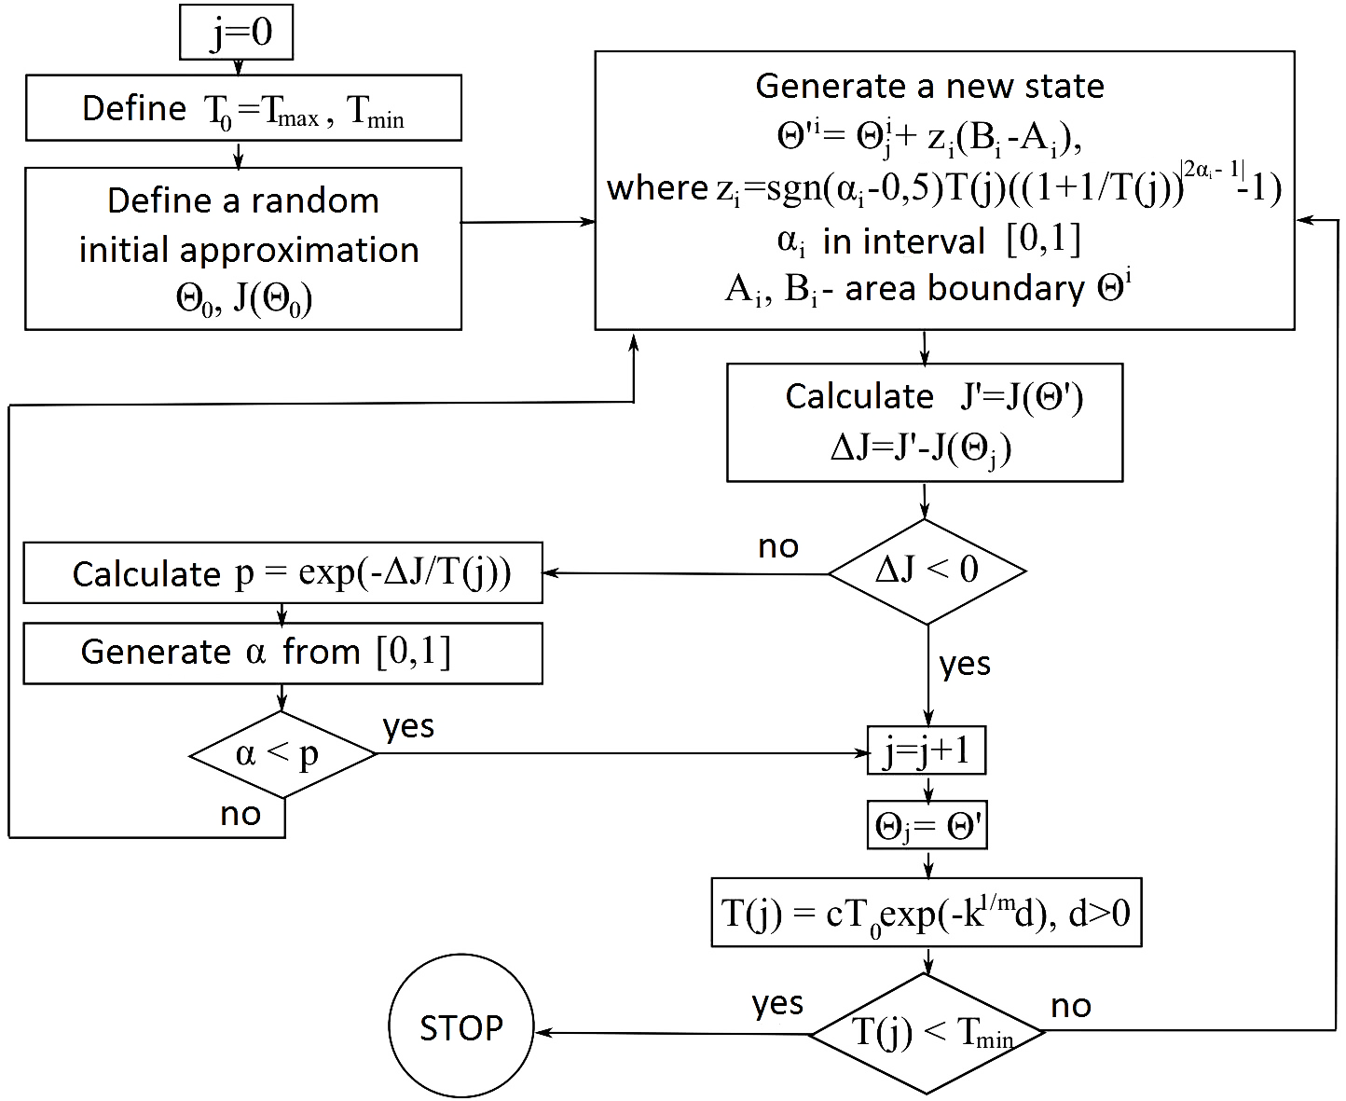
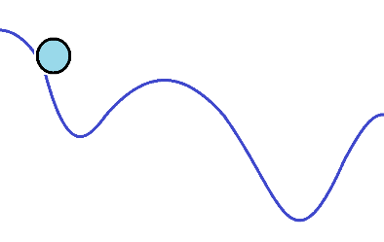



The simulated annealing method:
Stochastic convergence theorem:
L. Ingber. Very fast simulated re-annealing. Mathematical and Computer Modelling. –1989. –Vol. 12. –P. 967- 973.
A. Zhigliavsky, A. Zilinskas. Stochastic global optimization. Springer, 2008.

Slide 29
Methods :
Analytical
Heuristic / statistical :
Simulated annealing method
Advantages :
Global optimization method
Starts without any initial approximations
Quickly converges to area of exact solution
Simple
Same for any function
Limits :
Statistical
Weakly converge to exact solution
Stochastic convergence theorem:
L. Ingber. Very fast simulated re-annealing. Mathematical and Computer Modelling. –1989. –Vol. 12. –P. 967- 973.
A. Zhigliavsky, A. Zilinskas. Stochastic global optimization. Springer, 2008.
3

Slide 30

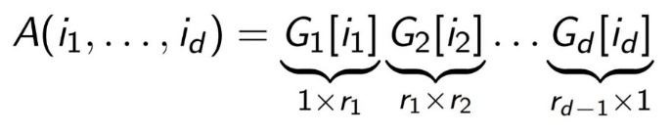
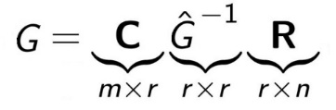
Methods :
Analytical :
Tensor Train (TT) method
Heuristic / statistical :
Simulated annealing method
Advantages :
Global optimization method
Starts without any initial approximations
Quickly converges to area of exact solution
Simple
Same for any function
Limits :
Statistical
Weakly converge to exact solution
Tensor :
TT-decomposition :
Searching of maximal volume submatrix :
Stochastic convergence theorem:
L. Ingber. Very fast simulated re-annealing. Mathematical and Computer Modelling. –1989. –Vol. 12. –P. 967- 973.
A. Zhigliavsky, A. Zilinskas. Stochastic global optimization. Springer, 2008.
3

Slide 31
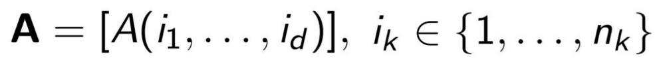


I. V. Oseledets. Tensor-train decomposition. SIAM J. Sci. Comput. – 2011. –Vol. 33. –P.2295–2317.
D. A. Zheltkov, I. V. Oferkin, E. V. Katkova, A. V. Sulimov, V. B. Sulimov and E. E. Tyrtyshnikov. TTDock: A docking method based on tensor train decompositions. Vychisl. Met. Programm. . –2013 . –Vol. 14 . –P. 279–291.
Tensor Train (TT) method *:
Tensor :
TT-decomposition :
Searching of maximal volume submatrix :

Slide 32
Methods :
Analytical :
Tensor Train (TT) method
Heuristic / statistical :
Simulated annealing method
Advantages :
Global optimization method
Starts without any initial approximations
Quickly converges to area of exact solution
Semi-Analytical
Limits :
Needs a lot of memory
Weakly converge to exact solution
Advantages :
Global optimization method
Starts without any initial approximations
Quickly converges to area of exact solution
Simple
Same for any function
Limits :
Statistical
Weakly converge to exact solution
I. V. Oseledets. Tensor-train decomposition. SIAM J. Sci. Comput. – 2011. –Vol. 33. –P.2295–2317.
D. A. Zheltkov, I. V. Oferkin, E. V. Katkova, A. V. Sulimov, V. B. Sulimov and E. E. Tyrtyshnikov. TTDock: A docking method based on tensor train decompositions. Vychisl. Met. Programm. . –2013 . –Vol. 14 . –P. 279–291.
Stochastic convergence theorem:
L. Ingber. Very fast simulated re-annealing. Mathematical and Computer Modelling. –1989. –Vol. 12. –P. 967- 973.
A. Zhigliavsky, A. Zilinskas. Stochastic global optimization. Springer, 2008.
3

Slide 33
Methods improvement idea :
Global optimization method to get the area of global minimum
Local optimization method to get quicker the exact minimum
4

Slide 34
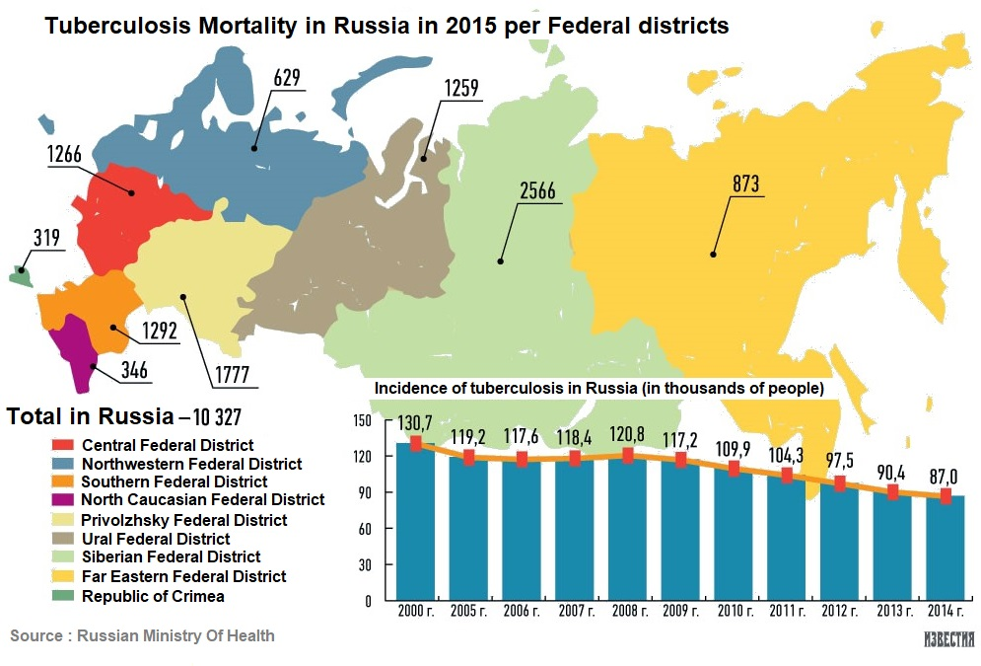
Epidemic situation in Russia : TB
5

Slide 35
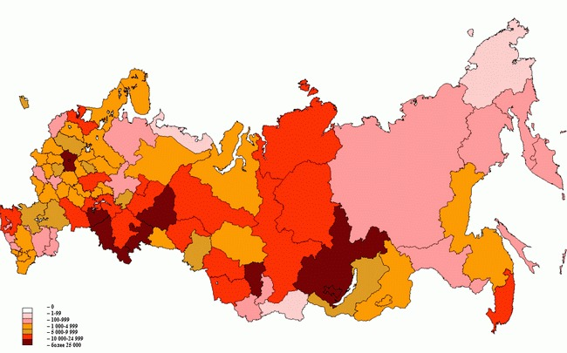
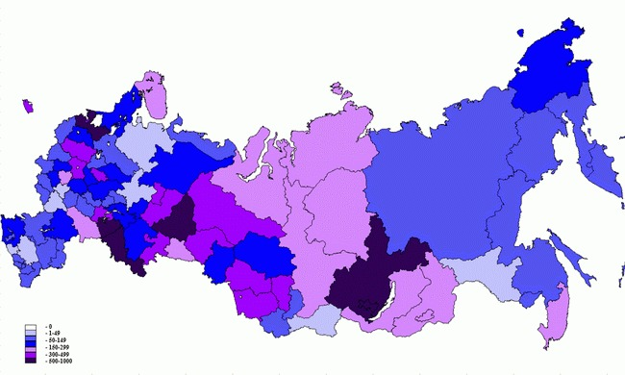
Epidemic situation in Russia : HIV
Fig.1 Distribution of registered cases of HIV infection in the territories of Russia of December 31, 2012, excluding children with an unidentified diagnosis.
Fig.2 Number of people living with HIV / AIDS in Russia per 100,000 population of December 31, 2012.
6

Slide 36
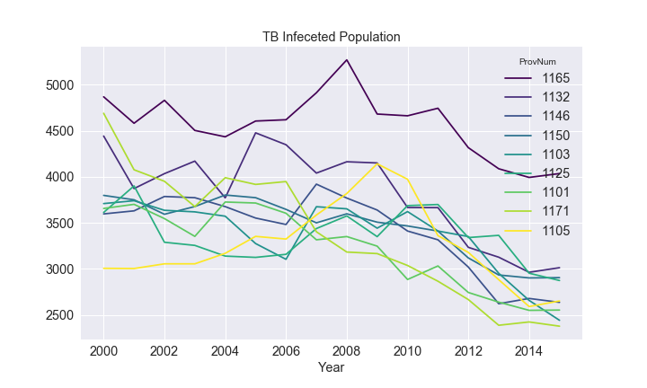
Epidemic situation in Russia : TB
Highly endemic regions :
  1165 : Sverdlovsk region
  1132 : Kemerovo region
  1146 : Moscow region
  1150 : Novosibirsk region
  1103 : Krasnodar region
  1125 : Irkutsk region
  1101 : Altai territory
  1171 : Tyumen region
* www.fedstat.ru
*** http://old.mednet.ru/ru/czentr-monitoringa-tuberkuleza

Slide 37
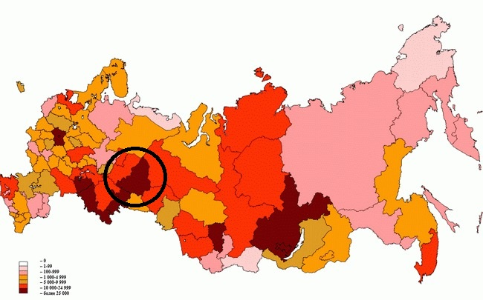
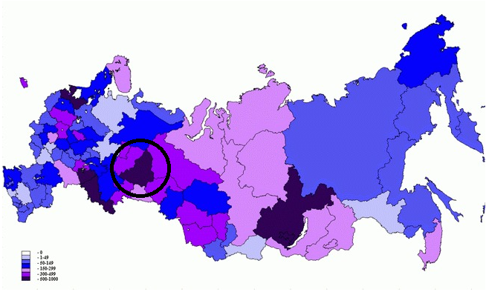
Investigated area (1165 - Sverdlovsk region) :
Fig.1 Distribution of registered cases of HIV infection in the territories of Russia of December 31, 2012, excluding children with an unidentified diagnosis.
* www.fedstat.ru
** www.hivrussia.ru/stat/
*** http://old.mednet.ru/ru/czentr-monitoringa-tuberkuleza
Fig.2 Number of people living with HIV / AIDS in Russia per 100,000 population of December 31, 2012.
7

Slide 38
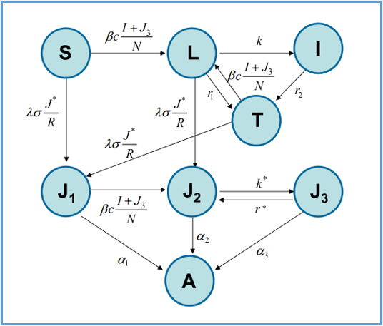


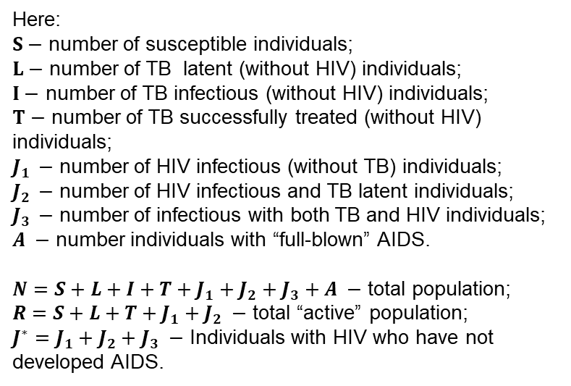
A mathematical model of the spread of a co-infection of tuberculosis and HIV, developed by group of American researchers (2009 г.)*:
Here:
$S−$ number of susceptible individuals;
$L−$ number of TB latent (without HIV) individuals;
$I−$ number of TB infectious (without HIV) individuals;
$T−$ number of TB successfully treated (without HIV) individuals;
$J_{1 }−$ number of HIV infectious (without TB) individuals;
$J_{2 }−$ number of HIV infectious and TB latent individuals;
$J_{3 }−$ number of infectious with both TB and HIV individuals;
$A −$ number individuals with “full-blown” AIDS.
$N=S+L+I+T+J_{1}+J_{2}+J_{3}+A −$ total population;
$R=S+L+T+J_{1}+J_{2} −$ total “active” population;
$J^{∗}=J_{1}+J_{2}+J_{3} −$ Individuals with HIV who have not developed AIDS.
Parameter description is given in a Table.
*L. W. Roeger, Z. Feng and C. Castillo-Chavez. Modeling TB and HIV co-infections. Mathematical biosciences and engineering. – 2009. – Vol. 6(4). – P. 815-837.
8

Slide 39
A mathematical model of the spread of a co-infection of tuberculosis and HIV, developed by group of American researchers (2009 г.)*:
Here:
$S−$ number of susceptible individuals;
$L−$ number of TB latent (without HIV) individuals;
$I−$ number of TB infectious (without HIV) individuals;
$T−$ number of TB successfully treated (without HIV) individuals;
$J_{1 }−$ number of HIV infectious (without TB) individuals;
$J_{2 }−$ number of HIV infectious and TB latent individuals;
$J_{3 }−$ number of infectious with both TB and HIV individuals;
$A −$ number individuals with “full-blown” AIDS.
$N=S+L+I+T+J_{1}+J_{2}+J_{3}+A −$ total population;
$R=S+L+T+J_{1}+J_{2} −$ total “active” population;
$J^{∗}=J_{1}+J_{2}+J_{3} −$ Individuals with HIV who have not developed AIDS.
Parameter description is given in a Table.
*L. W. Roeger, Z. Feng and C. Castillo-Chavez. Modeling TB and HIV co-infections. Mathematical biosciences and engineering. – 2009. – Vol. 6(4). – P. 815-837.
8

Slide 40
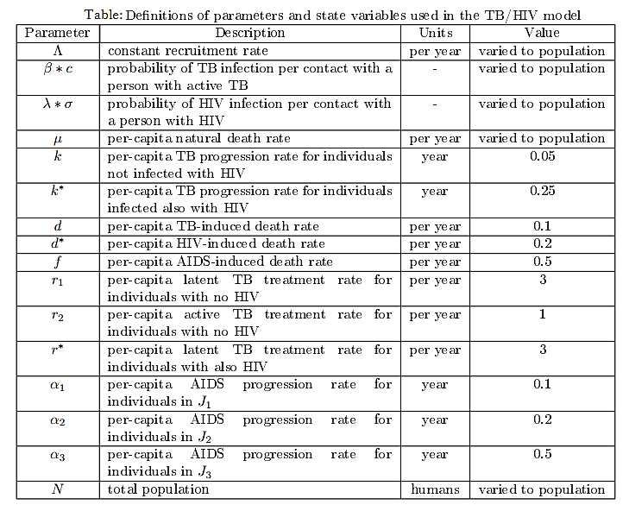
A mathematical model of the spread of a co-infection of tuberculosis and HIV, developed by group of American researchers (2009 г.)*:
Here:
$S−$ number of susceptible individuals;
$L−$ number of TB latent (without HIV) individuals;
$I−$ number of TB infectious (without HIV) individuals;
$T−$ number of TB successfully treated (without HIV) individuals;
$J_{1 }−$ number of HIV infectious (without TB) individuals;
$J_{2 }−$ number of HIV infectious and TB latent individuals;
$J_{3 }−$ number of infectious with both TB and HIV individuals;
$A −$ number individuals with “full-blown” AIDS.
$N=S+L+I+T+J_{1}+J_{2}+J_{3}+A −$ total population;
$R=S+L+T+J_{1}+J_{2} −$ total “active” population;
$J^{∗}=J_{1}+J_{2}+J_{3} −$ Individuals with HIV who have not developed AIDS.
Parameter description is given in a Table.
*L. W. Roeger, Z. Feng and C. Castillo-Chavez. Modeling TB and HIV co-infections. Mathematical biosciences and engineering. – 2009. – Vol. 6(4). – P. 815-837.
8

Slide 41
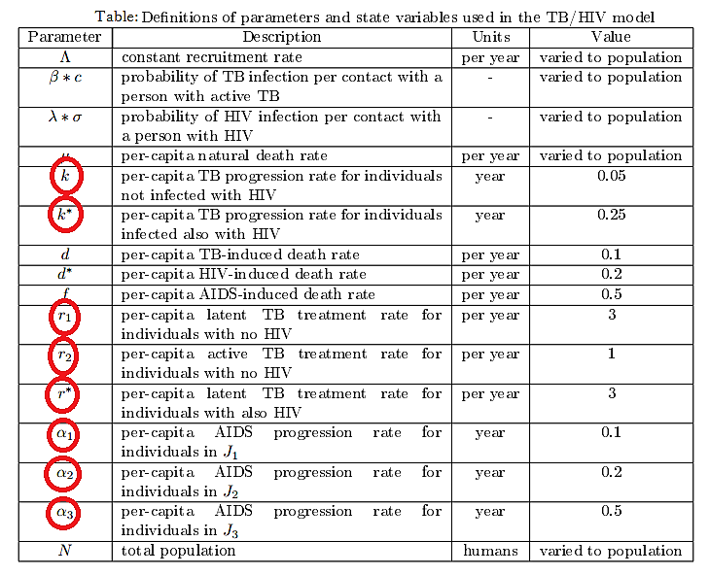
A mathematical model of the spread of a co-infection of tuberculosis and HIV, developed by group of American researchers (2009 г.)*:
Here:
$S−$ number of susceptible individuals;
$L−$ number of TB latent (without HIV) individuals;
$I−$ number of TB infectious (without HIV) individuals;
$T−$ number of TB successfully treated (without HIV) individuals;
$J_{1 }−$ number of HIV infectious (without TB) individuals;
$J_{2 }−$ number of HIV infectious and TB latent individuals;
$J_{3 }−$ number of infectious with both TB and HIV individuals;
$A −$ number individuals with “full-blown” AIDS.
$N=S+L+I+T+J_{1}+J_{2}+J_{3}+A −$ total population;
$R=S+L+T+J_{1}+J_{2} −$ total “active” population;
$J^{∗}=J_{1}+J_{2}+J_{3} −$ Individuals with HIV who have not developed AIDS.
Parameter description is given in a Table.
* Kabanikhin, S.I., Krivorotko, O., Kashtanova, V., Latyshenko, V. Identification the mathematical model of the transmission TB/HIV co-infection in endemic areas. 2017 International Multi-Conference on Engineering, Computer and Information Sciences (SIBIRCON). – 2017. – P. 77-81.
8

Slide 42
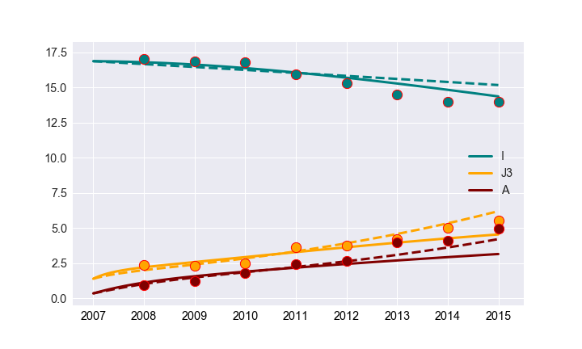
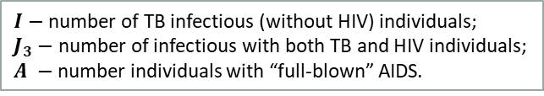
Results : Numerical solution of the parameters identification problem for Sverdlovsk region
– Simulated annealing method
-- Tensor Train method
$I$ $−$ number of TB infectious (without HIV) individuals;
$J_{3}−$ number of infectious with both TB and HIV individuals;
$A −$ number individuals with “full-blown” AIDS.
* www.fedstat.ru
** www.hivrussia.ru/stat/
*** http://old.mednet.ru/ru/czentr-monitoringa-tuberkuleza
9

Slide 43
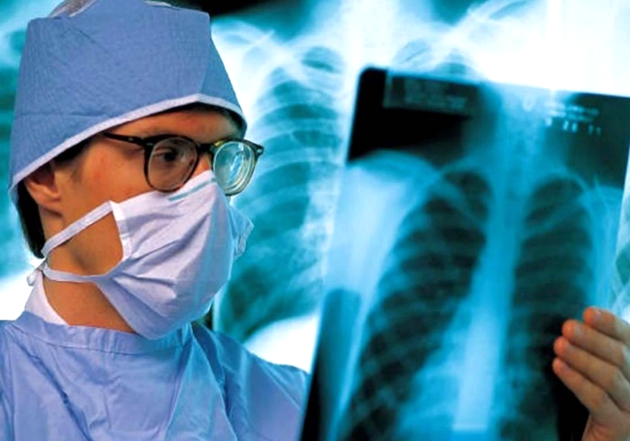

Conclusion :
Mathematical modeling for epidemics prediction is very convenient and profitable.
Each mathematical model should be “rebuild" for a specific population.
Optimization methods allows to "rebuild" any model for specific population using only statistical information.
Choice of the method depends on the problem or computing resources.
For better results we need to use more information.
10

Slide 44
Content
Inverse and Ill-Posed Problems.
Thermoacoustics.
HIV and tuberculosis.
Geophysics.

Slide 45
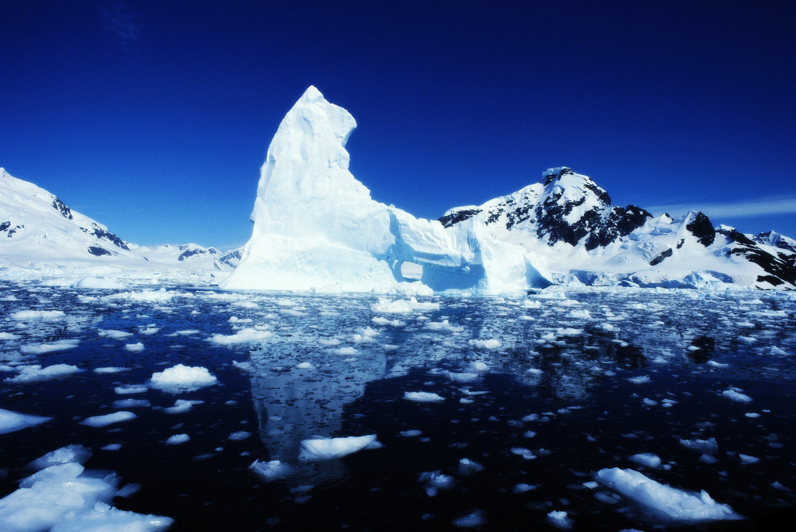

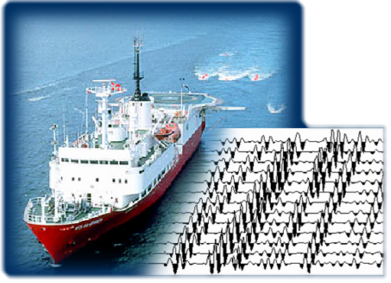
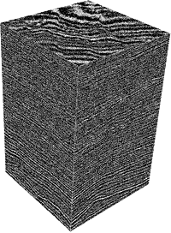

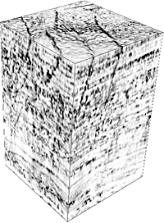
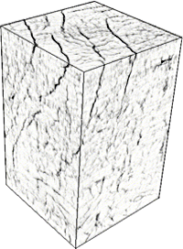
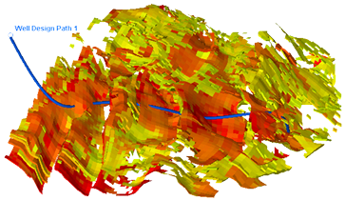
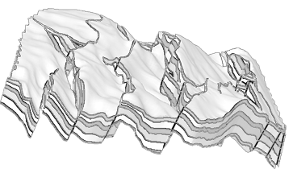
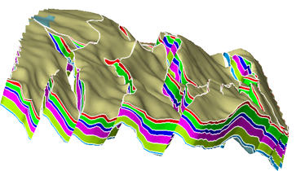
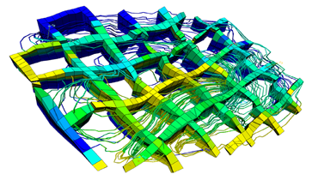
Siesmic data
Deconvolution, filtration
Drilling and correction
Structural model
Modeling of waves speed etc
Modeling оf a storage reservoir
Notes:
Pre-stack, post-stack, time domain, depth domain (after migration).
3D grid with streamlines.
Reservoir model and simulation.
Well-logs provide information not only for correcting the GEOMETRY (structiral model), but also tell the properties (porosity, permeability) in different volumetric zones.
«well logging» = каротаж
пористость, проницаемость
Всё крутится вокруг структурной модели.

Slide 46
Numerical solution of the 2D direct problem
Size of the computational domain 2 km x 1 km, mesh = 1 m.
Homogeneous speed model of the medium: Vp = 3 km/s, Vs=2km/s
Source function – Ricker wavelet (Frequency 50 Hz)
37 sources, located on the daylight surface (50m distance)
73 receivers, located on the daylight surface (25m distance)
Seismograms record time 2s, time step 0.001s
PML nodes along X= 50 PML length along x = 50.0 m
PML nodes along Z= 50 PML length along z = 50.0 m

Slide 47
Seismogram example
Seismogram example (source is located in the leftmost point)

Slide 48
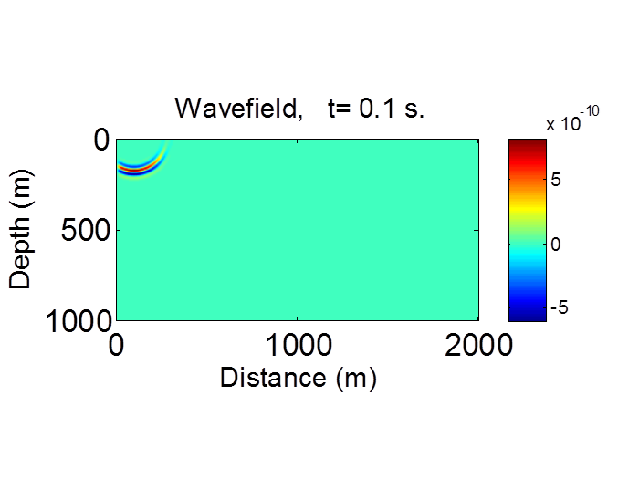
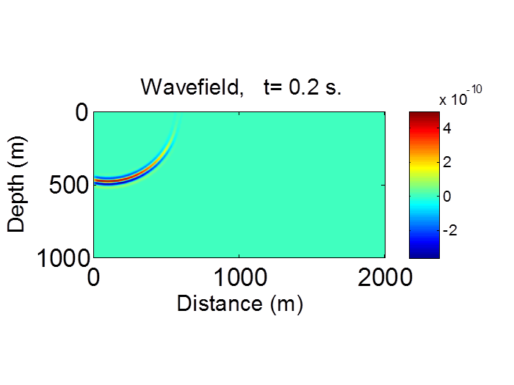




Wave field snapshots
Distribution of the wave front (source is located in the leftmost point)

Slide 49
Numerical solution of the 2D direct problem
Inverse problem data: series of the direct problems was calculated on the cluster on one node (12 cores). Parallelization was performed using MPI.
The calculation for one source on 12 cores took 15 minutes.
To calculate the total arrangement (37 sources) on one node (12 cores), it is required 555 minutes = 9.25 hours.
Estimated time for 3D problem is 40 000 hours (12 cores).

Slide 50

M.G. Krein method in 3D
(Kabanikhin, 1987; Kabanikhin, Satybaev, Shishlenin, 2004).
Inverse problem: find $ρ(x,y)$ using additional information at the plane $x=0$
All functions are supposed to be $2π$-periodic with respect to $y_{1}$ and $y_{2}$, i.e.
S.I. Kabanikhin. On linear regularization of multidimensional inverse problems for hyperbolic equations. Doklady RAS. Vol. 309, No. 4 (1989).

Slide 51
M.G. Krein method in 3D
The 3D analog of M.G. Krein equation
The solution of inverse problem can be obtained from the solution of
M.G. Krein equation by formula
Therefore in order to find solution ρ(x,y) in the depth x₀ we can solve
M.G. Krein equation with the fixed parameter x₀
and then calculate ρ(x₀ ,y) .

Slide 52




N- approximation of M.G. Krein equation in vector form
$$2Φ\left(x,t\right)−\sum_{|m|≤N}{\int_{−x}^{x}{F\left(t−s\right)Φ\left(x,s\right)ds=G, t∈\left(−x,x\right), k_{j}=−\overline{N,N}, j=1,2.}}$$
Here $Φ\left(x,t\right)={\left(Φ^{\left(−N\right)}\left(x,t\right),…,Φ^{\left(0\right)}\left(x,t\right),…,Φ^{(N)}\left(x,t\right)\right)}^{T}$,
$G={\left(G^{\left(−N\right)},…,G^{\left(0\right)},…,G^{\left(N\right)}\right)}^{T}$ and $G^{(k)}=−\int_{−π}^{π}{\frac{e^{i(k,y)}}{ρ(0,y)}dy}$.
$$F\left(t\right)= \left|\begin{aligned}\begin{matrix}{f_{−N}^{(−N)}}^{′} & {f_{−N+1}^{(−N)}}^{′} & … \\ {f_{−N}^{(−N+1)}}^{′} & {f_{−N+1}^{(−N+1)}}^{′} & … \\ ⋮ & ⋮ & …\end{matrix} \begin{matrix}{f_{0}^{(−N)}}^{′} & … & {f_{N}^{(−N)}}^{′} \\ {f_{0}^{(−N+1)}}^{′} & … & {f_{N}^{(−N+1)}}^{′} \\ ⋮ & … & ⋮\end{matrix} \\ \begin{matrix}{f_{−N}^{(0)}}^{′} & {f_{−N+1}^{(0)}}^{′} & … \\ ⋮ & ⋮ & … \\ {f_{−N}^{(N)}}^{′} & {f_{−N+1}^{(N)}}^{′} & … \end{matrix} \begin{matrix}{f_{0}^{(0)}}^{′} & … & {f_{N}^{(0)}}^{′} \\ ⋮ & … & ⋮ \\ {f_{0}^{(N)}}^{′} & … & {f_{N}^{(N)}}^{′}\end{matrix}\end{aligned}\right|$$

Slide 53
Let be the mesh size.
After discretization of Gelfand-Levitan-Krein equation we obtain the following system
Therefore the matrix has the dimension
where n is the mesh size, N is the number of Fourier coefficients.
In 2D in the domain 3 х 3 км² with h=5м and number of Fourier coefficients is equal to 50 matrix has a dimension 120000².
For the cube 3 х 3 ч 3 км³ – matrix has the dimension 12000000².

Slide 54
Fast inversion of block-Toeplitz matrix
We use the fast inversion of the block-toeplitz matrix proposed by V.V. Voevodin and E.E. Tyrtyshnikov.
The algorithm is based on the recursive Levinson-Durbin method.
V.V. Voevodin, E.E. Tyrtyshnikov. Computational processes with Toeplix matrices. Moscow, 1987.
S.I. Kabanikhin, N.S. Novikov, I.V. Oseledets, and M.A. Shishlenin. Fast Toeplitz linear system inversion for solving two-dimensional acoustic inverse problem. Journal of Inverse and Ill-Posed Problems, 2015. Vol. 23, No. 6.

Slide 55

Stochastic algorithm for singular decomposition
for matrices of large dimension
Let the matrix A have a sufficiently large dimension, and we are going to construct a randomized approximation for the first k singular values and the corresponding right singular vectors.
The idea is to choose a random submatrix of the matrix A by randomly choosing the s rows of the matrix A, forming the s x s matrix $SS^{T}$, and calculating its right singular vectors.
It was proved (Johnson-Linderstrauss) that the randomized approximation has the same properties as the initial large matrix.
K.K. Sabelfeld, N.S. Mozartova. Sparsified Randomization algorithms for low rank approximations and applications to integral equations and inhomogeneous random field simulation. Mathematics and Computers in Simulation 82(2), (2011)

Slide 56

Stochastic algorithm for singular decomposition
for matrices of large dimension
Algorithm
1. We choose an integer s: s > k and s << m.
2. For j = 1 to s, execute the loop:
Let us select a random row j but the distribution ${\left\{p\right\}}_{j=1}^{m}$ and include the string $A_{(j)}/\sqrt{{sp}_{j}}$ in the matrix S of the dimension s x n.
3. We construct the matrix $SS^{T}$and its SVD decomposition.
$$SS^{T}=\sum_{j=1}^{s}{λ_{j}^{2}ω^{(j)}}ω^{\left(j\right)T}$$
4. We compute $h^{(j)}=S^{T}ω^{\left(j\right)}/|S^{T}ω^{\left(j\right)}|$ for j = 1, ..., k. We form the matrix $H_{k}$ from the column $h^{(j)}$, where $λ_{1}$, ..., $λ_{k}$ are approximations for the first k of the singular values of the matrix A.
Thus we obtain the k-rank approximation of the matrix A in the form ${AH}_{k}H_{k}^{T}$ .

Slide 57



Stochastic algorithm for singular decomposition
for matrices of large dimension
К.К. Сабельфельд, Н. Моцартова
Теорема
Алгоритм

Slide 58
Numerical results, GLK, 2% error
Exact
Sources=1
Sources=6
Sources=11
Sources=16
Sources=21

Slide 59
Numerical results, GLK
Exact
Exact
Sources=1
Sources=6
Sources=11
Sources=21

Slide 60
Numerical results, GLK, 2%
Exact
Sources=1
Sources=6
Sources=11
Sources=16
Sources=21

Slide 61




Numerical results, GLK
Test problem: to determine inclusion in a 2d medium
Constant wave speed: 2.5 km/s. Maximal depth 2.5 km, travel time coordinates
Test 1: Smooth medium + inclusion
Exact
Sources=1
Sources=7
Sources=11

Slide 62






Numerical results, GLK
Test 2: Horizontally-layered structure + inclusion
Exact
Sources=1
Sources=5
Sources=7
Sources=11
Sources=15

Slide 63






Numerical results, GLK
Test 3: Complex layered structure + 2 inclusions
Exact
Sources=1
Sources=5
Sources=7
Sources=11
Sources=15

Slide 64




Numerical results, GLK
Test 4: Complex layered structure + 2 inclusions + 5% noise
Exact
Sources=7
Sources=11
Sources=15

Slide 65
Thank you for your attention!

