Slide 1
XIII International Asian School-seminar “Problems of complex system’s optimization”
Yermolenko D.V.,
Kabanikhin S. I., Krivorotko O. I.
NUMERICAL METHODS FOR SOLVING OPTIMIZATION PROBLEMS FOR THE MATHEMATICAL MODEL OF HIV DYNAMICS
Novosibirsk, 2017

Slide 2
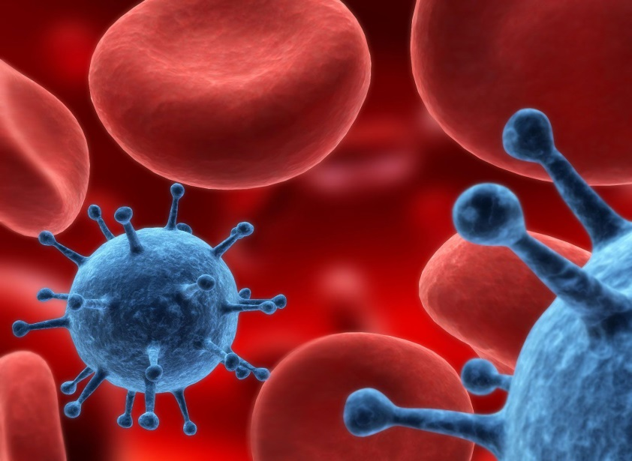
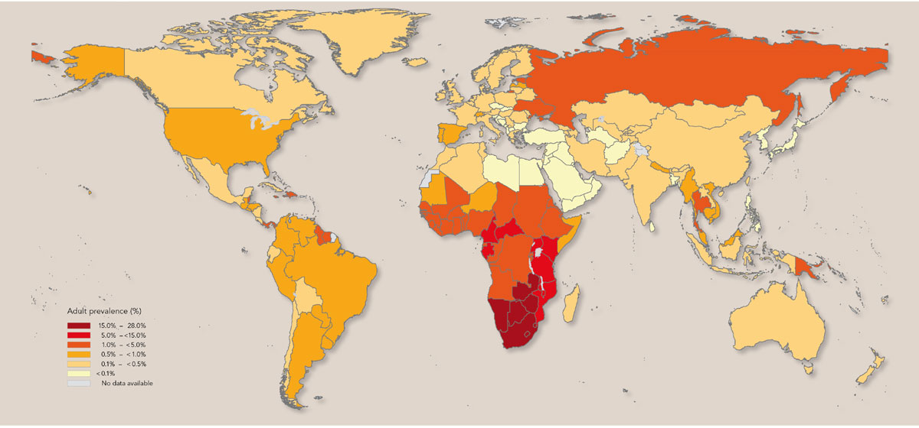
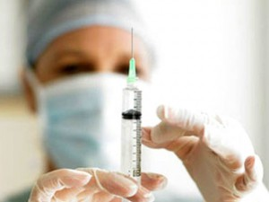
Motivation
HIV was discovered independently in 1983 in France and in the USA
HIV in the world
There are 31-35 million HIV-infected people in the world
As of 01.01.2017, there were > 1.5 million people HIV infected in Russia
Ineffective, non-optimal treatment
Standard Treatment Plan
1

Slide 3
A brief historical overview
A.S. Perelson, P.W. Nelson, 1999
Research of different HIV models. Solution of direct problems. Derivation and
investigation of stable states
B.M. Adams, H.T. Banks et al., 2005
Definition of two parameters for HIV model, derivation of the suboptimal control
of treatment
G. Bocharov et al., 2015
Determination of treatment functions for mathematical models of
HIV dynamics, which consist of 4 equations
K. Hattaf∗, M. Rachik et al, 2009
Determination of optimal treatment control for mathematical models of Tuberculosis
F. Castiglione∗, B. Piccoli et al, 2007
Determination of optimal treatment control for mathematical models of infectious disease
Objective: find the numerical solution of the parameters identification problem for the mathematical model of HIV dynamics and select the optimal control of treatment for a single particular patient.

Slide 4
Mathematical model of HIV dynamic with treatment
B.M. Adams, H.T. Banks et al., 2005
$$T_{1}$$ | Uninfected CD4 Т-lymphocytes
$${T_{1}}^{∗}$$ | Infected CD4 Т-lymphocytes
$$T_{2}$$ | Uninfected macrophages
$${T_{2}}^{∗}$$ | Infected macrophages
$$V$$ | Free virus
$$E$$ | Immune effectors (CD-cells)

Slide 5
Mathematical model of HIV dynamic with treatment
B.M. Adams, H.T. Banks et al., 2005
is a treatment parameter
$$T_{1}$$ | Uninfected CD4 Т-lymphocytes
$${T_{1}}^{∗}$$ | Infected CD4 Т-lymphocytes
$$T_{2}$$ | Uninfected macrophages
$${T_{2}}^{∗}$$ | Infected macrophages
$$V$$ | Free virus
$$E$$ | Immune effectors (CD-cells)

Slide 6
Mathematical model of HIV dynamic with treatment
B.M. Adams, H.T. Banks et al., 2005
19 parameters
$$T_{1}$$ | Uninfected CD4 Т-lymphocytes
$${T_{1}}^{∗}$$ | Infected CD4 Т-lymphocytes
$$T_{2}$$ | Uninfected macrophages
$${T_{2}}^{∗}$$ | Infected macrophages
$$V$$ | Free virus
$$E$$ | Immune effectors (CD-cells)

Slide 7
Mathematical model of HIV dynamic with treatment
B.M. Adams, H.T. Banks et al., 2005
19 parameters
D.S. Callaway, A.S. Perelson. HIV-1 infection and low steady state viral loads, Bull. Math. Biol. V. 64 (2001) P. 29–64.
Modifiable parameters
$$k_{1}$$ | Infection rate of CD4 T-lymphocytes
$$k_{2}$$ | Infection rate of macrophages
$$λ_{1}$$ | Target cell CD4 T-lymphocytes production (source) rate
$$λ_{2}$$ | Target cell macrophages production (source) rate
$$T_{1}$$ | Uninfected CD4 Т-lymphocytes
$${T_{1}}^{∗}$$ | Infected CD4 Т-lymphocytes
$$T_{2}$$ | Uninfected macrophages
$${T_{2}}^{∗}$$ | Infected macrophages
$$V$$ | Free virus
$$E$$ | Immune effectors (CD-cells)

Slide 8
Inverse problem
$$\left\{\begin{aligned}\frac{dU}{dt}=P\left(U\left(t\right), p,ε\right), t∈\left(0,T\right) \\ U\left(0\right)=U_{0} \end{aligned}(1)\right. Here \left\{\begin{aligned}U={\left(T_{1},T_{2}, {T_{1}}^{∗},{T_{2}}^{∗},V,E\right)}^{T} \\ p= {\left(k_{1},k_{2},λ_{1},λ_{2}\right)}^{T} \\ U_{0 }={\left(5∗{10}^{5}, 4800, 5000, 10,{10}^{4},15\right)}^{T}\end{aligned}\right.$$
We investigate the model without treatment $ε=0.$
Partition of domain $(0, T)$: $t_{j}=jh_{t}, j=0,…,N_{t}, h_{t}= \frac{T}{N_{t}}, T=100, N_{t}=10000$
Additional measurements of concentrations at fixed times $t_{k}$, $k=1,…,K$:
$$\left\{\begin{aligned}T_{1}\left(t_{k}\right)+T_{1}^{∗}\left(t_{k}\right)=Φ_{1}\left(t_{k}\right), \\ V\left(t_{k}\right)=Φ_{2}\left(t_{k}\right), \\ E\left(t_{k}\right)=Φ_{3}\left(t_{k}\right), \end{aligned} (2)\right.$$
The inverse problem (1) - (2) is determine by the vector of parameters p, if we know the measurements of the concentration (2) at fixed times:
$$\min_{p}{J_{1}(p)}=\sum_{k=1}^{K}{{((T_{1}\left(t_{k};p\right)+T_{1}^{∗}\left(t_{k};p\right))−Φ_{1}\left(t_{k}\right))}^{2}}+{(V\left(t_{k};p\right)−Φ_{2}\left(t_{k}\right))}^{2}+{(E\left(t_{k};p\right)−Φ_{3}\left(t_{k}\right))}^{2}$$

Slide 9
The stability of the inverse problem
Using the linearization and discretization algorithm, one can obtain a linearized inverse problem:
$$Aq=Φ A\left(q+δq\right)=Φ+δΦ.$$
where $q$ – vector of model parameters, $Φ$ – additional information, $A$ – linearized matrix of inverse problem.
We have an estimate for the relative error of the solution: $\frac{\left\|δq\right\|}{\left\|q\right\|}≤Cond\left(A\right)\frac{\left\|δΦ\right\|}{\left\|Φ\right\|}, Cond\left(A\right)=\frac{σ_{max}}{σ_{min}}.$

Slide 10
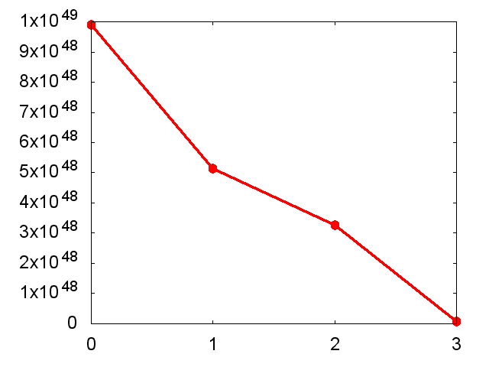
The stability of the inverse problem
Using the linearization and discretization algorithm, one can obtain a linearized inverse problem:
$$Aq=Φ A\left(q+δq\right)=Φ+δΦ.$$
where $q$ – vector of model parameters, $Φ$ – additional information, $A$ – linearized matrix of inverse problem.
We have an estimate for the relative error of the solution: $\frac{\left\|δq\right\|}{\left\|q\right\|}≤Cond\left(A\right)\frac{\left\|δΦ\right\|}{\left\|Φ\right\|}, Cond\left(A\right)=\frac{σ_{max}}{σ_{min}}.$
$q_{ex}={\left(λ_{1}^{ex}, λ_{2}^{ex}, k_{1}^{ex}, k_{2}^{ex}\right)}^{T}=({10}^{4}, 31.98, 8⋅{10}^{−7}, 8⋅{10}^{−4},{10}^{−4})$;
$q_{0}={\left(λ_{1}^{0}, λ_{2}^{0}, k_{1}^{0}, k_{2}^{0}\right)}^{T}=({4⋅10}^{4}, 40, 6⋅{10}^{−7}, 3⋅{10}^{−4})$;
$$σ_{1}$$ | $$≈9.9⋅{10}^{48}$$
$$σ_{2}$$ | $$≈5.1⋅{10}^{48}$$
$$σ_{3}$$ | $$≈3.3⋅{10}^{48}$$
$$σ_{4}$$ | $$≈7.5⋅{10}^{46}$$
$Cond\left(A\right)=\frac{σ_{1}}{σ_{4}}=1.32⋅{10}^{2}$

Slide 11
Genetic algorithm for solving an optimization problem min J(q)
1. CHOOSING THE INITIAL POPULATION:
Choose arbitrary values of $N$ vectors of parameters $q^{i}$.
For each $q^{i}$ we count the misfit function $J(q^{i})$.

Slide 12
Genetic algorithm for solving an optimization problem min J(q)
1. CHOOSING THE INITIAL POPULATION:
Choose arbitrary values of $N$ vectors of parameters $q^{i}$.
For each $q^{i}$ we count the misfit function $J(q^{i})$.
2. SELECTION:
Choose $N$ pairs of parents. The probability that $i$-th member of the population fall into a pair can be calculated as follows
$$P^{i}=\frac{J(q^{i})}{\sum_{j=1}^{N}{J(q^{j})}}.$$

Slide 13
Genetic algorithm for solving an optimization problem min J(q)
1. CHOOSING THE INITIAL POPULATION:
Choose arbitrary values of $N$ vectors of parameters $q^{i}$.
For each $q^{i}$ we count the misfit function $J(q^{i})$.
2. SELECTION:
Choose $N$ pairs of parents. The probability that $i$-th member of the population fall into a pair can be calculated as follows
$$P^{i}=\frac{J(q^{i})}{\sum_{j=1}^{N}{J(q^{j})}}.$$
3. CROSSING:
$Q$ is random integer number from $[1,K]$,
$R$ is a random integer (1 or 2).
$\left({q_{1}}^{i},…{q_{s}}^{i},|{q_{s+1}}^{i}…,{q_{K}}^{i}\right)$ + $\left({q_{1}}^{j},…{q_{s}}^{j},|{q_{s+1}}^{j}…,{q_{K}}^{j}\right)$
$Q=s, R=1$ $Q=s, R=2$
$\left({q_{1}}^{i},…{q_{s}}^{i},|{q_{s+1}}^{j}…,{q_{K}}^{j}\right)$ $\left({q_{1}}^{j},…{q_{s}}^{j},|{q_{s+1}}^{i}…,{q_{K}}^{i}\right)$

Slide 14
Genetic algorithm for solving an optimization problem min J(q)
1. CHOOSING THE INITIAL POPULATION:
Choose arbitrary values of $N$ vectors of parameters $q^{i}$.
For each $q^{i}$ we count the misfit function $J(q^{i})$.
2. SELECTION:
Choose $N$ pairs of parents. The probability that $i$-th member of the population fall into a pair can be calculated as follows
$$P^{i}=\frac{J(q^{i})}{\sum_{j=1}^{N}{J(q^{j})}}.$$
3. CROSSING:
$Q$ is random integer number from $[1,K]$,
$R$ is a random integer (1 or 2).
$\left({q_{1}}^{i},…{q_{s}}^{i},|{q_{s+1}}^{i}…,{q_{K}}^{i}\right)$ + $\left({q_{1}}^{j},…{q_{s}}^{j},|{q_{s+1}}^{j}…,{q_{K}}^{j}\right)$
$Q=s, R=1$ $Q=s, R=2$
$\left({q_{1}}^{i},…{q_{s}}^{i},|{q_{s+1}}^{j}…,{q_{K}}^{j}\right)$ $\left({q_{1}}^{j},…{q_{s}}^{j},|{q_{s+1}}^{i}…,{q_{K}}^{i}\right)$
4. MUTATION:
Make random changes in the posterity, i.e.
Choose a random volume of descendants, to which the mutation will be applied.
Then we choose random item numbers of descendants that will mutate.
For each mutating descendant we choose random volume of mutating elements.
Then we choose random item numbers of mutating element and replace each element to a new random value from the allowable period.

Slide 15
Genetic algorithm for solving an optimization problem min J(q)
1. CHOOSING THE INITIAL POPULATION:
Choose arbitrary values of $N$ vectors of parameters $q^{i}$.
For each $q^{i}$ we count the misfit function $J(q^{i})$.
2. SELECTION:
Choose $N$ pairs of parents. The probability that $i$-th member of the population fall into a pair can be calculated as follows
$$P^{i}=\frac{J(q^{i})}{\sum_{j=1}^{N}{J(q^{j})}}.$$
5. FORMATION OF A NEW GENERATION:
Choose the member that has the lowest value of the functional $J(q^{i})$. Choose a few "lucky ones" , who have bigger values of $J$, but they will bring diversity in subsequent generations.
3. CROSSING:
$Q$ is random integer number from $[1,K]$,
$R$ is a random integer (1 or 2).
$\left({q_{1}}^{i},…{q_{s}}^{i},|{q_{s+1}}^{i}…,{q_{K}}^{i}\right)$ + $\left({q_{1}}^{j},…{q_{s}}^{j},|{q_{s+1}}^{j}…,{q_{K}}^{j}\right)$
$Q=s, R=1$ $Q=s, R=2$
$\left({q_{1}}^{i},…{q_{s}}^{i},|{q_{s+1}}^{j}…,{q_{K}}^{j}\right)$ $\left({q_{1}}^{j},…{q_{s}}^{j},|{q_{s+1}}^{i}…,{q_{K}}^{i}\right)$
4. MUTATION:
Make random changes in the posterity, i.e.
Choose a random volume of descendants, to which the mutation will be applied.
Then we choose random item numbers of descendants that will mutate.
For each mutating descendant we choose random volume of mutating elements.
Then we choose random item numbers of mutating element and replace each element to a new random value from the allowable period.

Slide 16
Genetic algorithm for solving an optimization problem min J(q)
1. CHOOSING THE INITIAL POPULATION:
Choose arbitrary values of $N$ vectors of parameters $q^{i}$.
For each $q^{i}$ we count the misfit function $J(q^{i})$.
6. CHECK THE EXIT CONDITIONS:
The lowest value of the misfit function $J\left(q^{i}\right)$ less then $∆={10}^{−3}$.
The smallest value of the misfit function from population changes less than ${10}^{−8}$ within 500 consecutive iterations.
2. SELECTION:
Choose $N$ pairs of parents. The probability that $i$-th member of the population fall into a pair can be calculated as follows
$$P^{i}=\frac{J(q^{i})}{\sum_{j=1}^{N}{J(q^{j})}}.$$
5. FORMATION OF A NEW GENERATION:
Choose the member that has the lowest value of the functional $J(q^{i})$. Choose a few "lucky ones" , who have bigger values of $J$, but they will bring diversity in subsequent generations.
3. CROSSING:
$Q$ is random integer number from $[1,K]$,
$R$ is a random integer (1 or 2).
$\left({q_{1}}^{i},…{q_{s}}^{i},|{q_{s+1}}^{i}…,{q_{K}}^{i}\right)$ + $\left({q_{1}}^{j},…{q_{s}}^{j},|{q_{s+1}}^{j}…,{q_{K}}^{j}\right)$
$Q=s, R=1$ $Q=s, R=2$
$\left({q_{1}}^{i},…{q_{s}}^{i},|{q_{s+1}}^{j}…,{q_{K}}^{j}\right)$ $\left({q_{1}}^{j},…{q_{s}}^{j},|{q_{s+1}}^{i}…,{q_{K}}^{i}\right)$
4. MUTATION:
Make random changes in the posterity, i.e.
Choose a random volume of descendants, to which the mutation will be applied.
Then we choose random item numbers of descendants that will mutate.
For each mutating descendant we choose random volume of mutating elements.
Then we choose random item numbers of mutating element and replace each element to a new random value from the allowable period.

Slide 17
Genetic algorithm for solving an optimization problem min J(q)
STOP
1. CHOOSING THE INITIAL POPULATION:
Choose arbitrary values of $N$ vectors of parameters $q^{i}$.
For each $q^{i}$ we count the misfit function $J(q^{i})$.
YES
6. CHECK THE EXIT CONDITIONS:
The lowest value of the misfit function $J\left(q^{i}\right)$ less then $∆={10}^{−3}$.
The smallest value of the misfit function from population changes less than ${10}^{−8}$ within 500 consecutive iterations.
2. SELECTION:
Choose $N$ pairs of parents. The probability that $i$-th member of the population fall into a pair can be calculated as follows
$$P^{i}=\frac{J(q^{i})}{\sum_{j=1}^{N}{J(q^{j})}}.$$
NO
5. FORMATION OF A NEW GENERATION:
Choose the member that has the lowest value of the functional $J(q^{i})$. Choose a few "lucky ones" , who have bigger values of $J$, but they will bring diversity in subsequent generations.
3. CROSSING:
$Q$ is random integer number from $[1,K]$,
$R$ is a random integer (1 or 2).
$\left({q_{1}}^{i},…{q_{s}}^{i},|{q_{s+1}}^{i}…,{q_{K}}^{i}\right)$ + $\left({q_{1}}^{j},…{q_{s}}^{j},|{q_{s+1}}^{j}…,{q_{K}}^{j}\right)$
$Q=s, R=1$ $Q=s, R=2$
$\left({q_{1}}^{i},…{q_{s}}^{i},|{q_{s+1}}^{j}…,{q_{K}}^{j}\right)$ $\left({q_{1}}^{j},…{q_{s}}^{j},|{q_{s+1}}^{i}…,{q_{K}}^{i}\right)$
4. MUTATION:
Make random changes in the posterity, i.e.
Choose a random volume of descendants, to which the mutation will be applied.
Then we choose random item numbers of descendants that will mutate.
For each mutating descendant we choose random volume of mutating elements.
Then we choose random item numbers of mutating element and replace each element to a new random value from the allowable period.

Slide 18
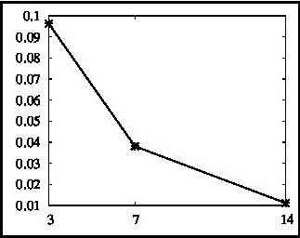
Numerical solving of an inverse problem (1)-(2) by genetic algorithm
$T=100$ days, $N_{t}=10000,$ $h_{t}=0,01$
$T_{1}(0)=50000$, $T_{2}(0)=4800$, ${T_{1}}^{∗}(0)=5000,$ ${T_{2}}^{∗}(0)=10,$ $V(0)=10000,$ $E(0)=15$
We generate a synthetic data using standard set of parameters for infected patient.
14 measurements (once a week)

Slide 19
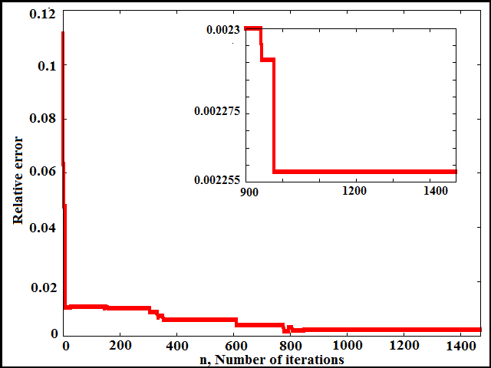
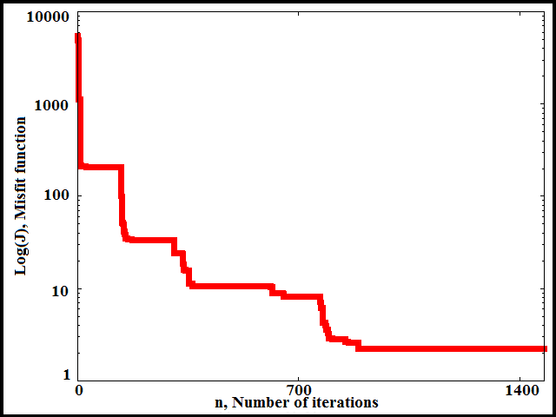
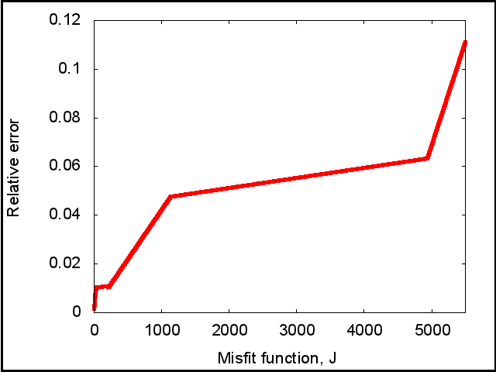
Numerical solution of an inverse problem (1)-(2)
$T=100$ days, $N_{t}=10000,$ $h_{t}=0.01$
Initial conditions:
$T_{1}=50000$, $T_{2}=4800$, ${T_{1}}^{∗}=5000,$
${T_{2}}^{∗}=10,$ $V=10000,$ $E=15$
Measurements for an inverse problem:
$\left\{\begin{aligned}T_{1}\left(t_{k}\right)+ {T_{1}}_{}^{∗}\left(t_{k}\right)=Φ_{1}\left(t_{k}\right), \\ V\left(t_{k}\right)=Φ_{2}\left(t_{k}\right), \\ E\left(t_{k}\right)=Φ_{3}\left(t_{k}\right), \end{aligned} \right.k=1,…,14$
 | Exact values | Approximate values | Relative accuracy error
$$λ_{1}\left(\frac{cells}{ml∙day}\right)$$ | $${10}^{4}$$ | $$1.0015∙{10}^{4}$$ | $$0.00149$$
$$λ_{2}\left(\frac{cells}{ml∙day}\right)$$ | $$31.98$$ | $$32.7881$$ | $$0.02527$$
$$k_{1}\left(\frac{ml}{virions∙day}\right)$$ | $$8∙{10}^{−7}$$ | $$7.9802∙{10}^{−7}$$ | $$0.00248$$
$$k_{2}\left(\frac{ml}{virions∙day}\right)$$ | $${10}^{−4}$$ | $$1.1693∙{10}^{−4}$$ | $$0.16933$$

Slide 20
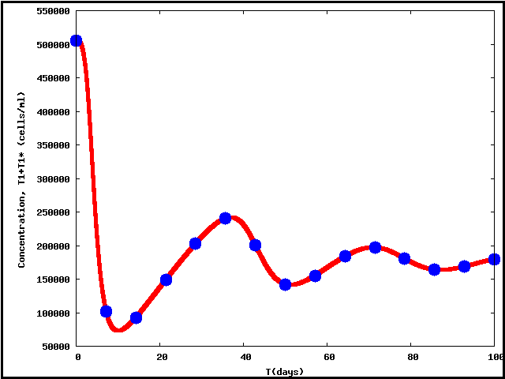
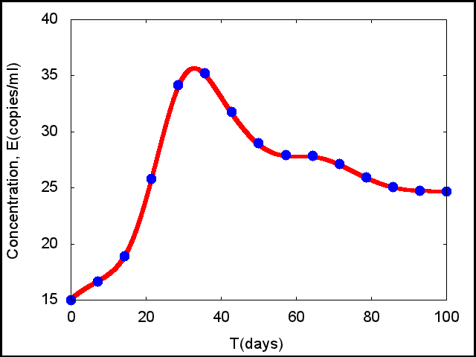
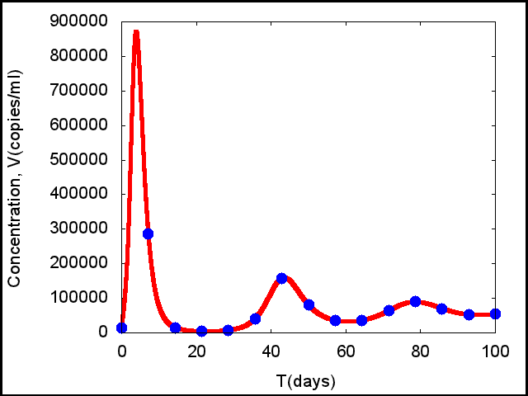
Fitting curves with measurements
Pictures are shown that relative accuracy error of four parameters identification is sufficiently small for getting such a good mathematical model that have a solution close to additional measurements of CD4 T-lymphocytes $(T_{1}+T_{1}^{∗})$, immune effectors $E$ and free viruses $V$.

Slide 21
Fitting curves with noised measurements
We add Gaussian noise in data of about 10 %
 | Exact parameters, $q_{ex}$ | Approximate parameters, $q$ | Relative error${ \left|q_{ex}^{i}−q^{i}\right|}/{\left|q_{ex}^{i}\right|}$
$$λ_{1}\left(\frac{cells}{ml⋅days}\right)$$ | $${10}^{4}$$ | $${0.0989⋅10}^{4}$$ | $$0.0107$$
$$λ_{2}\left(\frac{cells}{ml⋅days}\right)$$ | $$31.98$$ | $$43.7049$$ | $$0.3666$$
$$k_{1}\left(\frac{ml}{virions⋅days}\right)$$ | $$8⋅{10}^{−7}$$ | $$7.9949⋅{10}^{−7}$$ | $$0.0006$$
$$k_{2}\left(\frac{ml}{virions⋅days}\right)$$ | $${10}^{−4}$$ | $${0.5024⋅10}^{−4}$$ | $$0.4976$$

Slide 22
Pontryagin’s Maximum Principle for optimal treatment control
$\left\{\begin{aligned}\frac{dU_{i}}{dt}=P_{i}\left(U\left(t\right),ε\left(t\right)\right), i=1,…,6 \\ U_{i}\left(0\right)=U_{i0} t∈(0, T)\end{aligned}\right.$ (1) Here$U={\left(T_{1}, T_{2}, T_{1}^{∗}, T_{2}^{∗}, V, E\right)}^{T}.$
$J\left(ε\left(t\right)\right)= \int_{0}^{T}{Q⋅V\left(t\right)+R⋅ε^{2}\left(t\right)}dt ⟶\min_{ε(t)}$ (2)
Here $Q, R$ – weight constants
Pontryagin’s Maximum Principle* convert (1) – (2) into a problem :
$H=Q⋅V\left(t\right)+R⋅ε^{2}\left(t\right)+\sum_{i=1}^{6}{ξ_{i}⋅P_{i}}⟶$ $\min_{ε(t)}$
$$\left\{\begin{aligned}\frac{dξ_{i}}{dt}=−\frac{∂H}{∂U_{i}}, i=1,…,6 \\ ξ_{i}\left(T\right)=0. \end{aligned}\right.$$
Here $ξ_{i}$ satisfies the adjoint problem :
*L. S. Pontryagin, V. G. Boltyanskii et. all, The Mathematical Theory of Optimal Processes, Wiley, New York, 1962.

Slide 23
Off treatment (ε = 0) steady states for model and initial conditions
$EQ_{1}:$ $T_{1}={10}^{6}, T_{2}=3198, T_{1}^{∗}=0, T_{2}^{∗}=0, V=0, E=10.$(Unstable)
$EQ_{2}:$ $T_{1}=664938, T_{2}=50, T_{1}^{∗}=1207,$
${ T}_{2}^{∗}=11, V=6299, E=207658.$(Unstable)
$EQ_{3}:$ $T_{1}=163573, T_{2}=5, T_{1}^{∗}=11945$
$T_{2}^{∗}=46, V=63919, E=24.$ (Stable)
$EQ_{4}:$ $T_{1}=967839, T_{2}=621, T_{1}^{∗}=76, T_{2}^{∗}=6, V=415, E=353108$. (Stable)
$EQ_{1}$ represents the uninfected patient, without virus;
$EQ_{2}$ represents the infected patient with sufficiently
good immunity;
$EQ_{3}$ - a dangerously high viral load is present;
$EQ_{4}$ a strong immune response has developed.

Slide 24
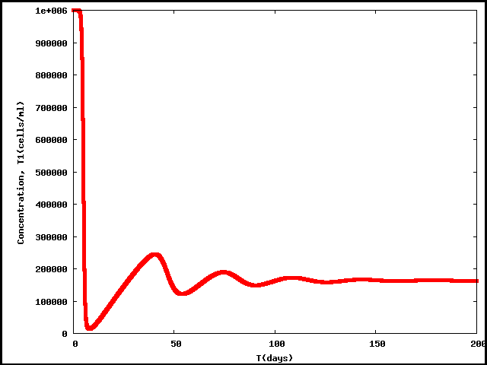
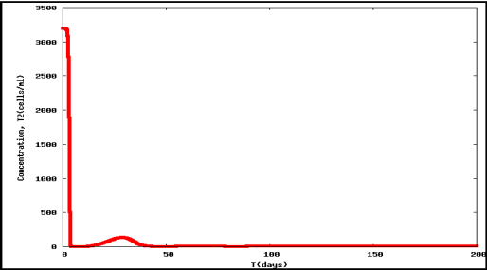
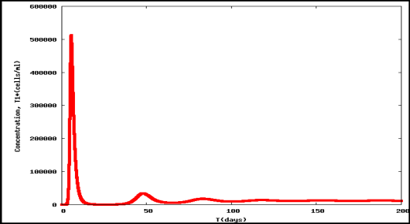
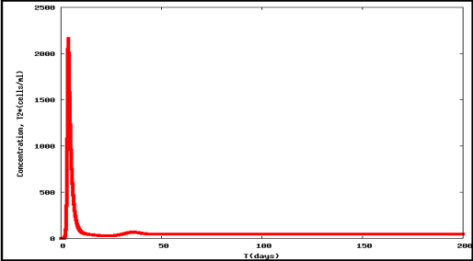
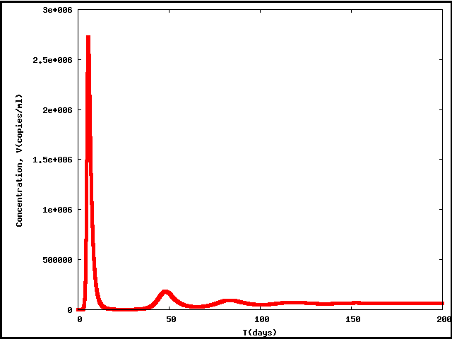
Off treatment (ε = 0) steady states for model and initial conditions
When the system is in state $EQ_{1}$, introduction of a small amount of virus causes the system to converge to $EQ_{3}$.
$EQ_{1}:$ $T_{1}={10}^{6}, T_{2}=3198, T_{1}^{∗}=0, T_{2}^{∗}=0, V=0, E=10.$(Unstable)
$EQ_{2}:$ $T_{1}=664938, T_{2}=50, T_{1}^{∗}=1207,$
${ T}_{2}^{∗}=11, V=6299, E=207658.$(Unstable)
$EQ_{3}:$ $T_{1}=163573, T_{2}=5, T_{1}^{∗}=11945$
$T_{2}^{∗}=46, V=63919, E=24.$ (Stable)
$EQ_{4}:$ $T_{1}=967839, T_{2}=621, T_{1}^{∗}=76, T_{2}^{∗}=6, V=415, E=353108$. (Stable)
$$T_{1}$$
$$T_{2}$$
$${T_{1}}^{∗}$$
$${T_{2}}^{∗}$$
$EQ_{1}$ represents the uninfected patient, without virus;
$EQ_{2}$ represents the infected patient with sufficiently
good immunity;
$EQ_{3}$ - a dangerously high viral load is present;
$EQ_{4}$ a strong immune response has developed.
$$V$$
$$E$$

Slide 25
Off treatment (ε = 0) steady states for model and initial conditions
When the system is in state $EQ_{1}$, introduction of a small amount of virus causes the system to converge to $EQ_{3}$.
$EQ_{1}:$ $T_{1}={10}^{6}, T_{2}=3198, T_{1}^{∗}=0, T_{2}^{∗}=0, V=0, E=10.$(Unstable)
$EQ_{2}:$ $T_{1}=664938, T_{2}=50, T_{1}^{∗}=1207,$
${ T}_{2}^{∗}=11, V=6299, E=207658.$(Unstable)
$EQ_{3}:$ $T_{1}=163573, T_{2}=5, T_{1}^{∗}=11945$
$T_{2}^{∗}=46, V=63919, E=24.$ (Stable)
$EQ_{4}:$ $T_{1}=967839, T_{2}=621, T_{1}^{∗}=76, T_{2}^{∗}=6, V=415, E=353108$. (Stable)
$$T_{1}$$
$$T_{2}$$
$${T_{1}}^{∗}$$
$${T_{2}}^{∗}$$
$EQ_{1}$ represents the uninfected patient, without virus;
$EQ_{2}$ represents the infected patient with sufficiently
good immunity;
$EQ_{3}$ - a dangerously high viral load is present;
$EQ_{4}$ a strong immune response has developed.
$$V$$
$$E$$
Initial conditions for optimal control problem (perturbed state $EQ_{1}$):
$$T_{1}={10}^{6}, T_{2}=3198, T_{1}^{∗}=0, T_{2}^{∗}=0, V=1, E=10.$$

Slide 26
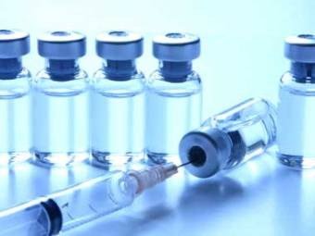
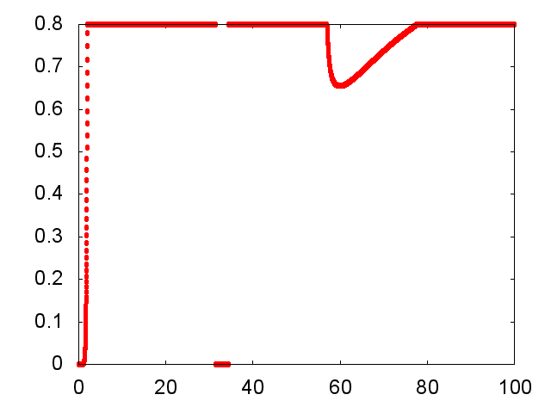
Optimal treatment (inverse problem 2)
$T=100$ days, $N_{t}=10000$
Initial conditions:
$T_{1}(0)={10}^{6}$, $T_{2}(0)=3198$, ${T_{1}}^{∗}\left(0\right)={10}^{−4},$
${T_{2}}^{∗}(0)={10}^{−4},$ $V(0)=1,$ $E(0)=10$
Misfit function:
$J\left(ε\right)=\int_{0}^{T}{RV\left(t\right)+Qε^{2}\left(t\right) dt}⟶min$
$R=0.1, Q=10000$
The optimal control problem convert to minimizing of Hamiltonian:
$H=Q⋅V\left(t\right)+R⋅ε^{2}(t)\sum_{i=1}^{6}{ξ_{i}⋅P_{i}}⟶$ $\min_{ε(t)}$
Here $ξ_{i}$ satisfies the adjoint problem :
$$\left\{\begin{aligned}\frac{dξ_{i}}{dt}=−\frac{∂H}{∂U_{i}}, i=1,…,6 \\ ξ_{i}\left(T\right)=0 \end{aligned}\right.$$

Slide 27
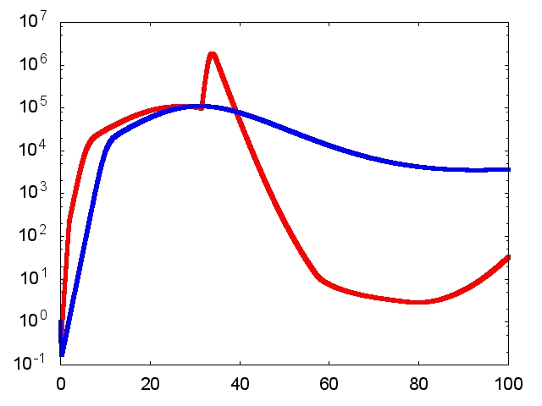
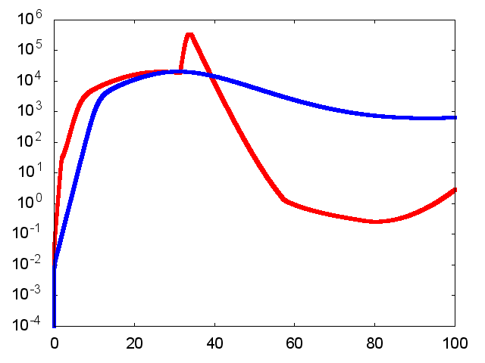
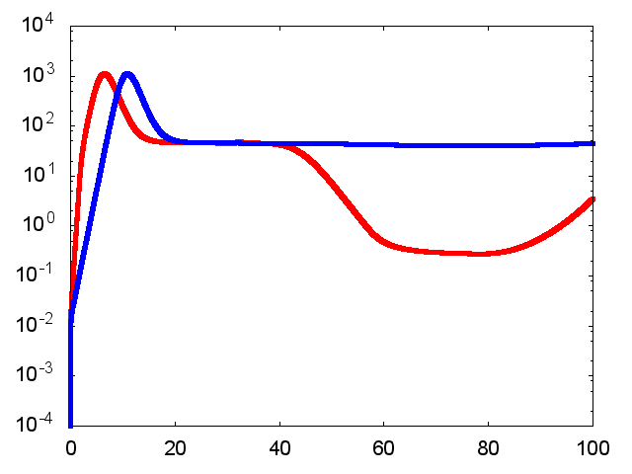
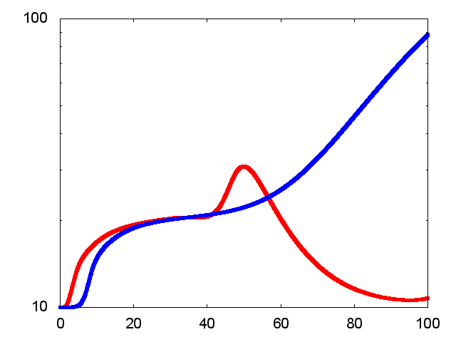
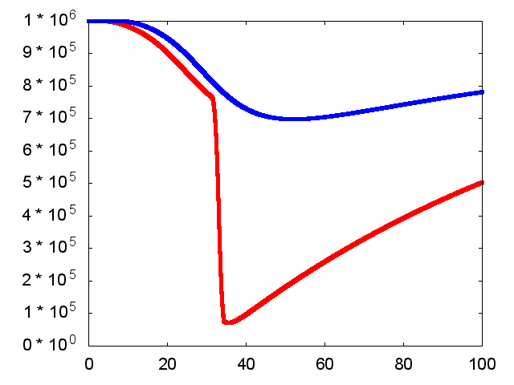
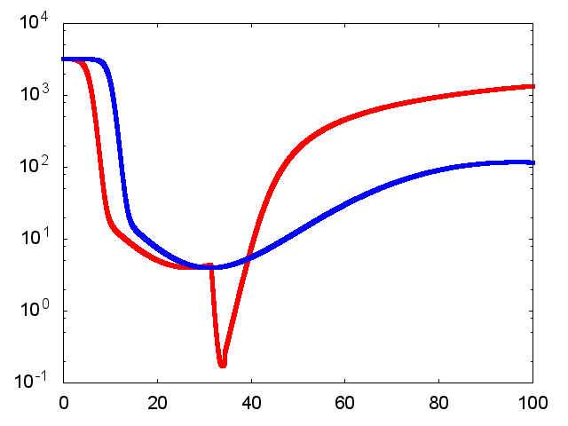
Mathematical modeling with full treatment (blue line) and with optimal treatment (red line)
$V$, free virus
${T_{1}}^{∗}$, infected CD4 T-lymphocytes
${T_{2}}^{∗}$, infected macrophages
$E$, immune effectors
$T_{1}$, uninfected CD4 T-lymphocytes
$T_{2}$, uninfected macrophages

Slide 28
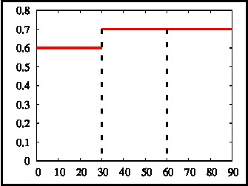
Optimal treatment (inverse problem 2)
$T=90$ days, $N_{t}=9000$
$ε= {\left(ε_{1}{,ε}_{2}{,ε}_{3} \right)}^{T}$, $ε_{i}∈\{0, 0.1, 0.2,0.3,0.4,0.5,0.6,0.7, 0.8\}$
Initial conditions:
$T_{1}={10}^{6}$, $T_{2}=3198$, ${T_{1}}^{∗}={10}^{−4}, {T_{2}}^{∗}={10}^{−4},$ $V=1,$ $E=10$
Misfit function:
$J_{2}\left(ε\right)=\int_{0}^{T}{RV\left(t\right)+Qε^{2}\left(t\right) dt}⟶min$
The optimal treatment control obtained by brute-force search:
$$ε_{1}$$ | $$0.6$$
$$ε_{2}$$ | $$0.7$$
$$ε_{3}$$ | $$0.7$$

Slide 29
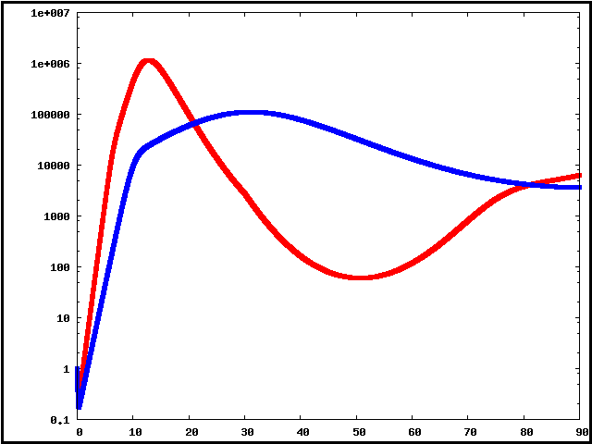
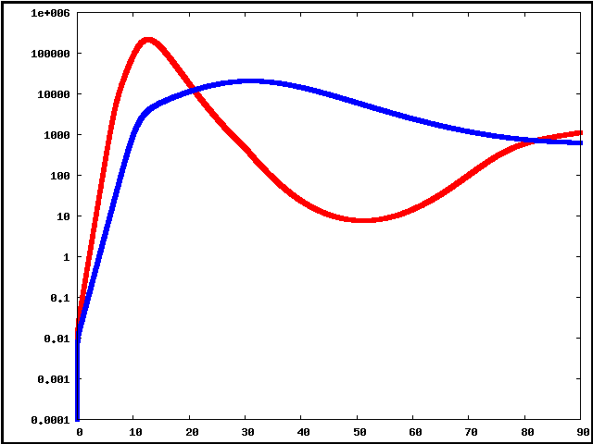
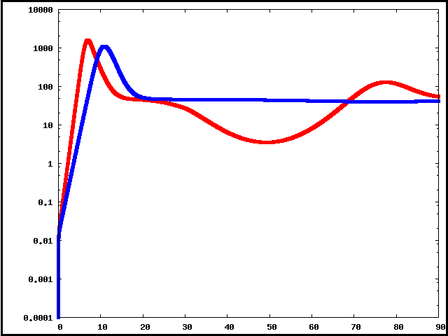
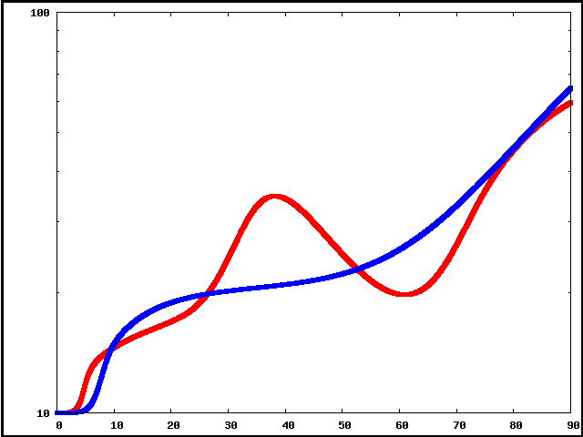
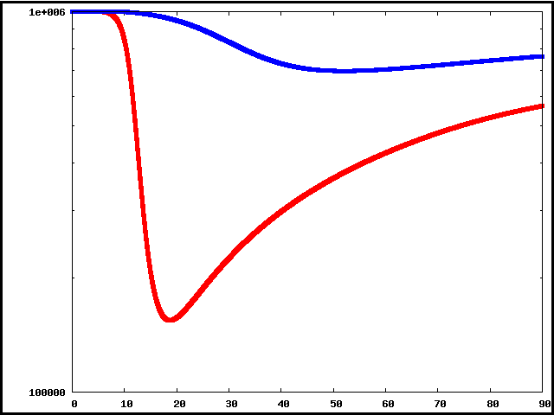
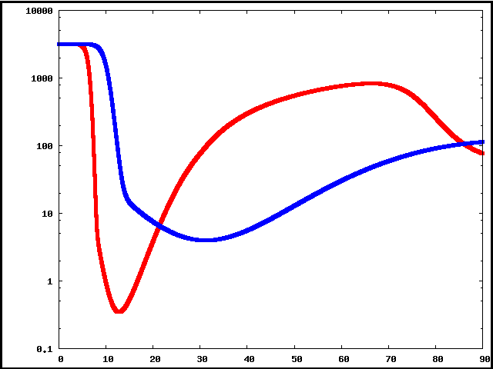
Mathematical modeling with full treatment (blue line) and with optimal treatment (red line)
$V$, free virus
${T_{1}}^{∗}$, infected CD4 T-lymphocytes
${T_{2}}^{∗}$, infected macrophages
$E$, immune effectors
$T_{1}$, uninfected CD4 T-lymphocytes
$T_{2}$, uninfected macrophages

Slide 30
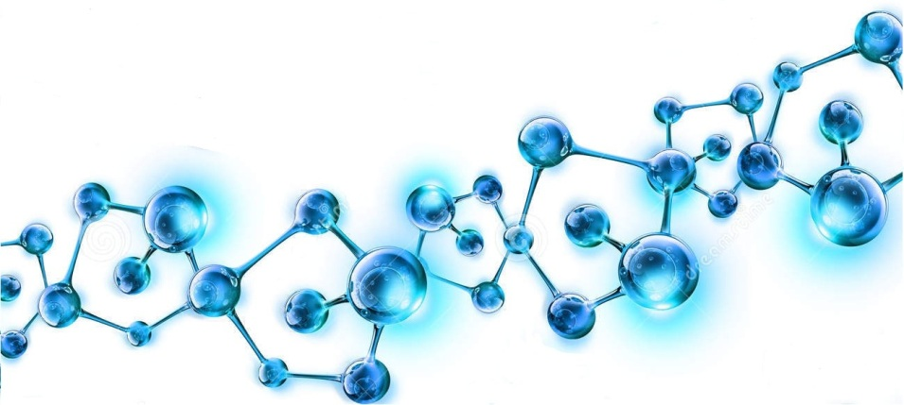
Thank you for attention!

Slide 31
Model parameters

Slide 32
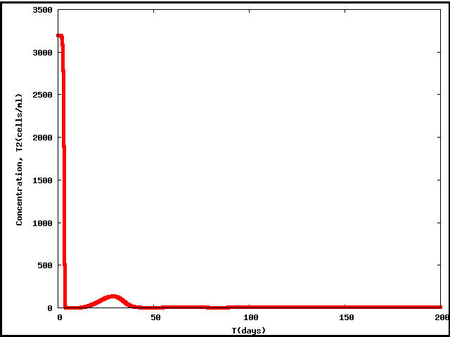
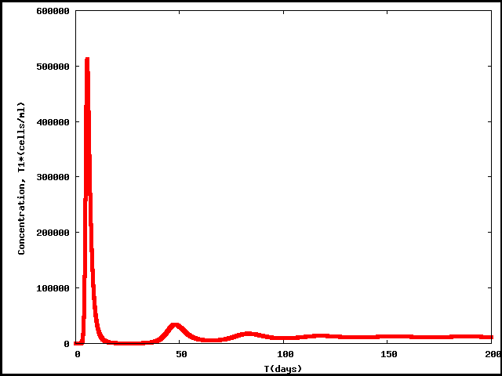
Transition from the state $EQ_{1}$ to $EQ_{3}$
$$T_{1}$$
$$T_{2}$$
$${T_{1}}^{∗}$$
$${T_{2}}^{∗}$$
$$V$$
$$E$$

Slide 33
Transition from the state $EQ_{1}$ to $EQ_{3}$
$$T_{1}$$
$$T_{2}$$
$${T_{1}}^{∗}$$
 | $$EQ_{1}$$ | Initial state | $$EQ_{3}$$ | Final state
$$T_{1}$$ | $$1000000$$ | $$1000000$$ | $$163573$$ | $$163159.21$$
$$T_{2}$$ | $$3198$$ | $$3198$$ | $$5$$ | $$5.026$$
$${T_{1}}^{∗}$$ | $$0$$ | $$0$$ | $$11945$$ | $$11866.2$$
$${T_{2}}^{∗}$$ | $$0$$ | $$0$$ | $$46$$ | $$45.58$$
$$V$$ | $$0$$ | $$1$$ | $$63919$$ | $$63508.42$$
$$E$$ | $$10$$ | $$10$$ | $$24$$ | $$23.57$$
$${T_{2}}^{∗}$$
$$V$$
$$E$$

