Slide 1
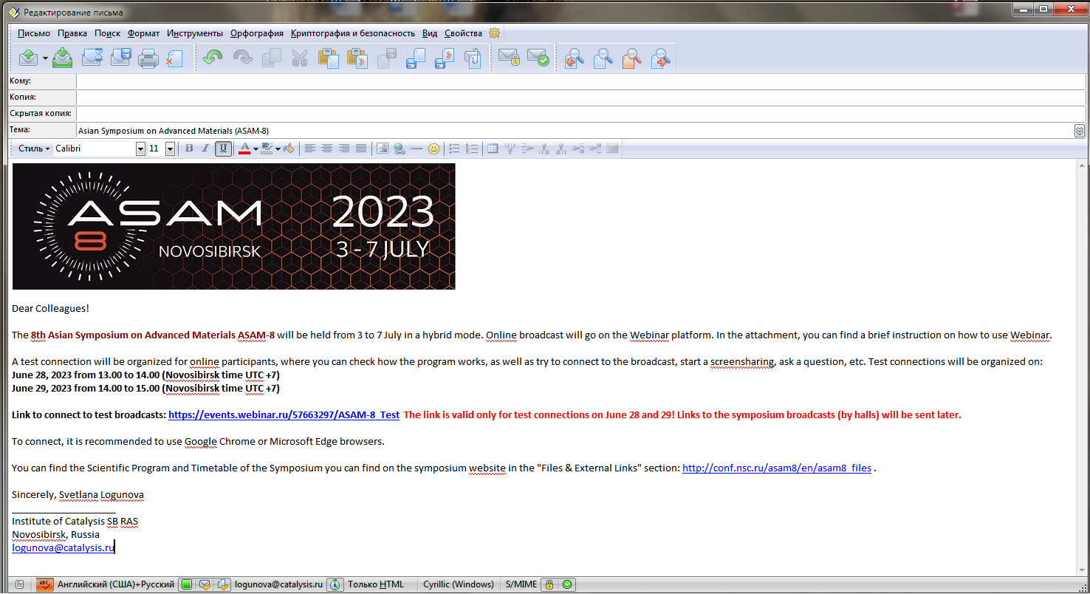
How to connect to the broadcast of the ASAM-8 symposium on the Webinar platform?
Brief instruction
1. Open the e-mail with the link to the broadcast. Open the link in Google Chrome or Microsoft Edge browser

Slide 2
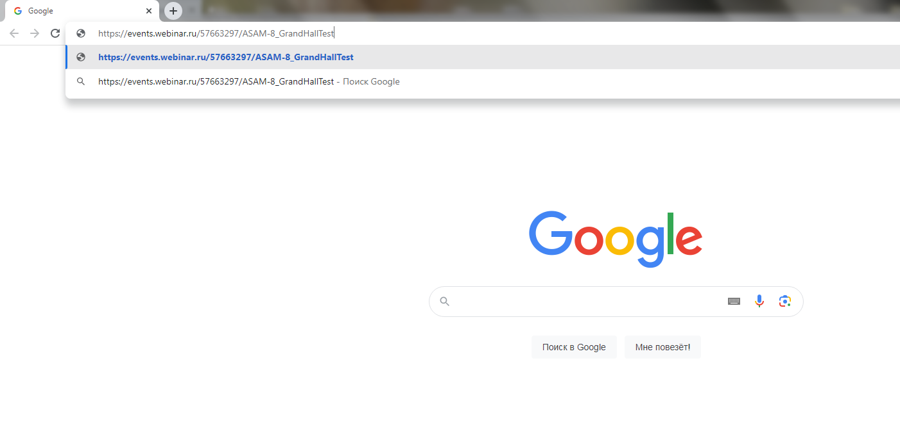
2. Use the Google Chrome or Microsoft Edge browser. Follow this link.

Slide 3
3. Click on SIGN UP

Slide 4
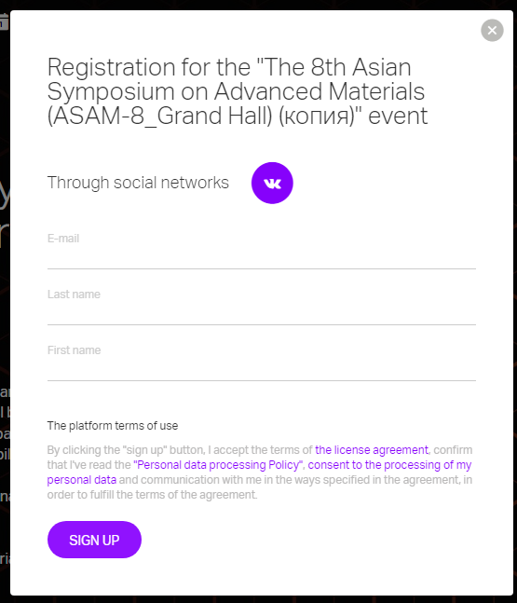
4. Type your email address, your First name and Last name.
Use the Latin keyboard layout.
Type your real first and last name.
Unidentified persons will not be allowed to broadcast.
Click on SIGN UP

Slide 5
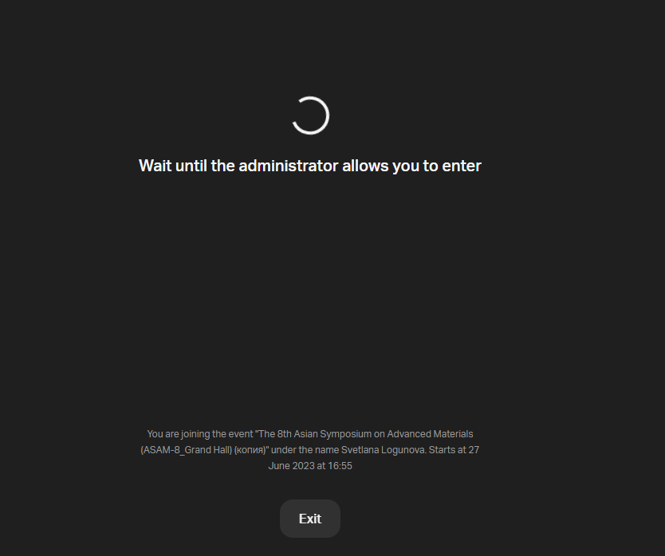
5. Please wait while the administrator finds your name in the list of symposium participants and allows you to enter to the broadcast.

Slide 6
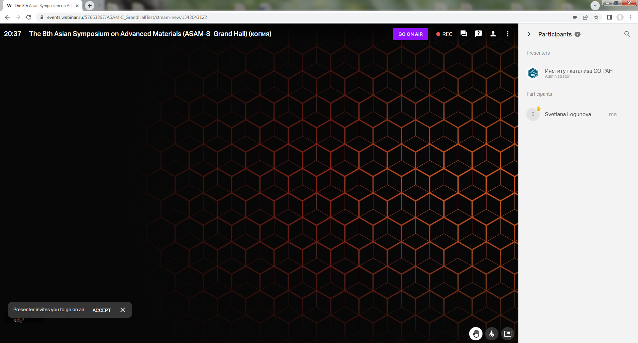
6. You are connected to the broadcast.
Chat to ask a question in writing
List of participants
«Raise your hand» icon to go on air and ask a question verbally or make a presentation

Slide 7
7.1. How to go on air?
To go on air and make an oral presentation, or ask a question in person:
Click the Raise Your Hand Icon
Wait for an invitation from the administrator to go live, click "ACCEPT"
Press the "GO ON AIR" icon
3. GO ON AIR
2. ACCEPT
1. Rise your hand

Slide 8
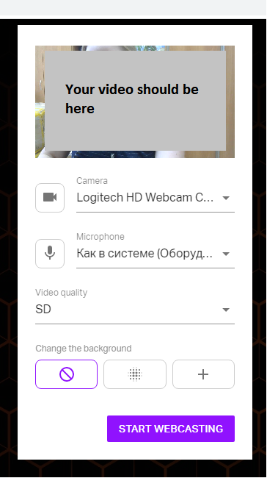
7.2. How to go on air?
Specify which video camera and microphone should be used.
Most often, the camera and microphone are detected automatically.
If you have multiple devices, select the one you need.
Click "START WEBCASTING"
You are on the air.

Slide 9
8.1. How to make a presentation?
Open the presentation on your computer.
In the lower left corner, click on the "Screensharing" monitor icon
Your video should be here

Slide 10
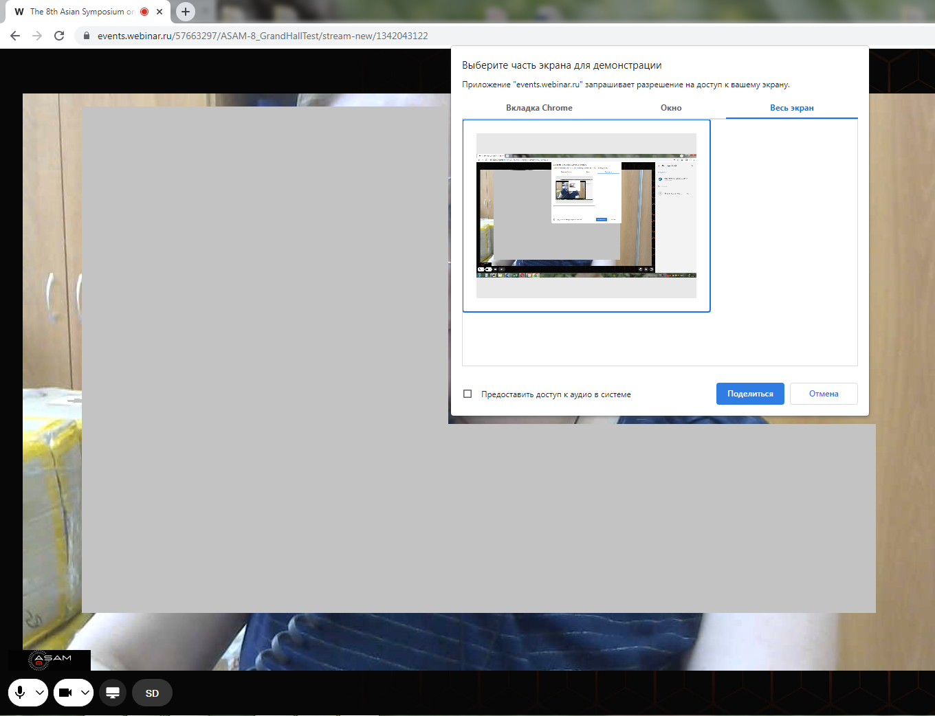
8.2. How to make a presentation?
Select «Весь экран» Unfortunately, there is no translation into English, the third option.
If you have multiple screens, select the one on which the presentation is open.
Click on the selected screen (a blue frame will appear around it)
Click “Поделиться» (a blue button on the bottom of the frame)
Open and run your presentation. Start your report.

Slide 11
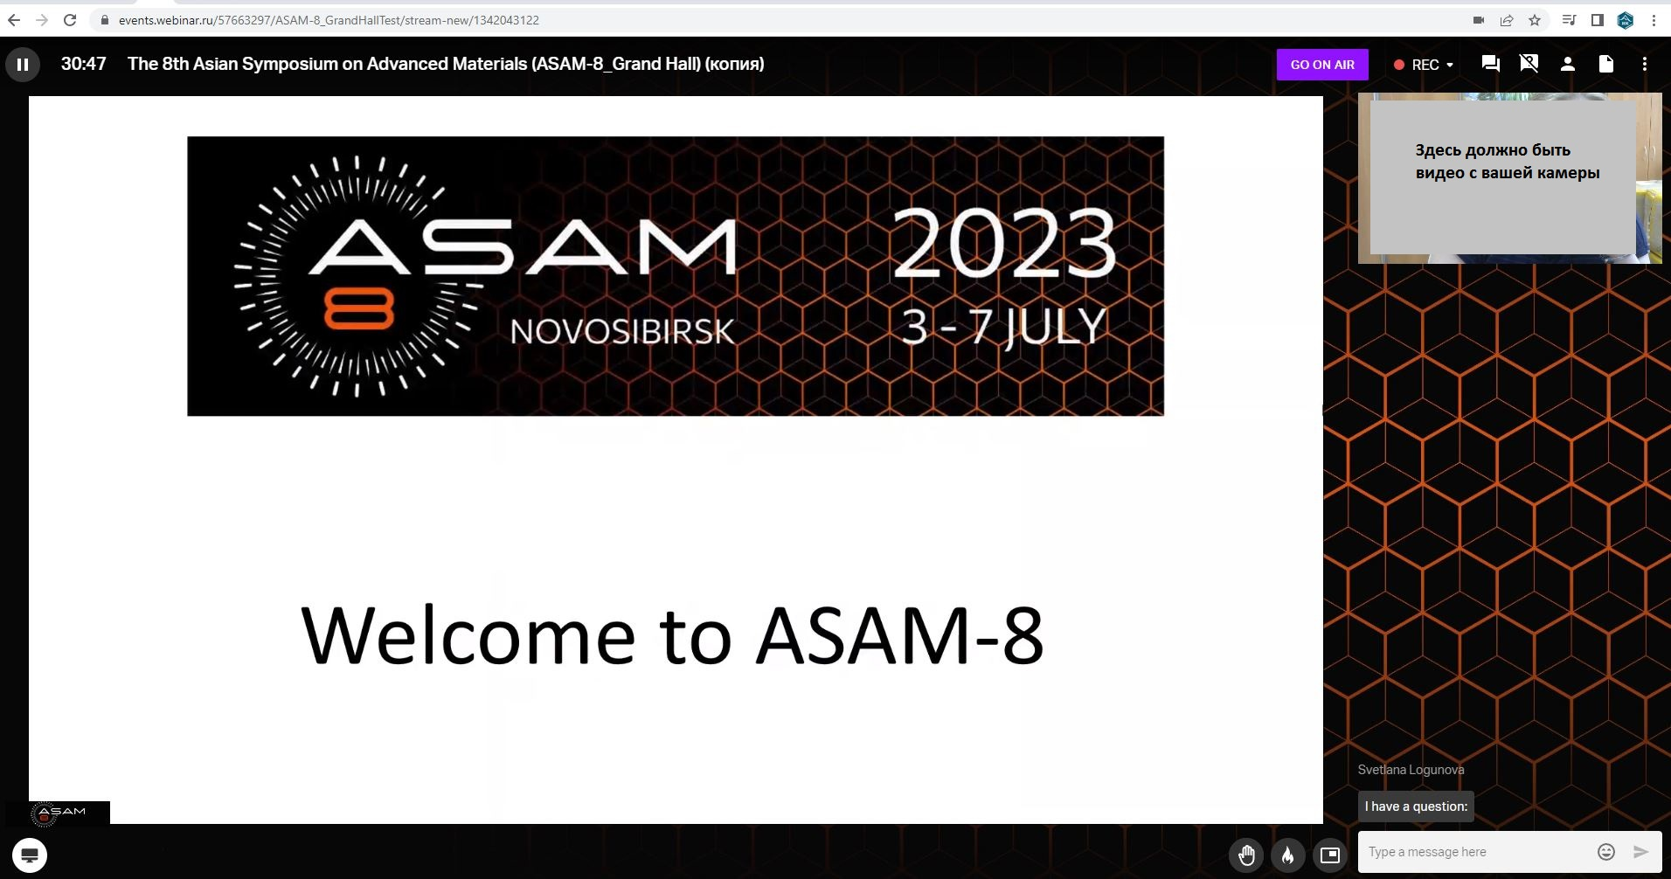
8.3. How to make a presentation?
This is how participants see your presentation:
Your presentation Video from your camera
video from your camera
You can ask questions in Chat

Slide 12
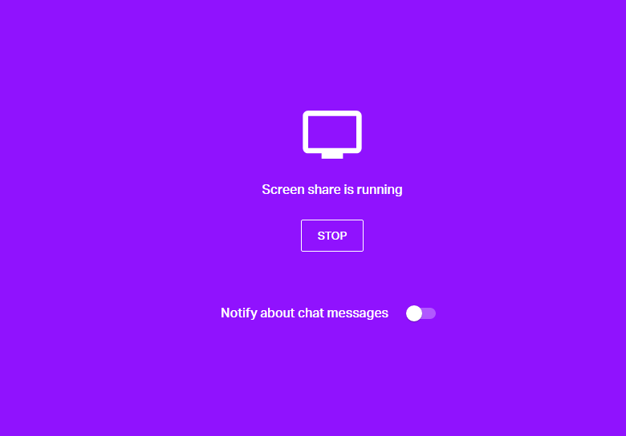
8.4. How to make a presentation?
After the presentation is over, stop the screen sharing by clicking on "STOP"

Slide 13
Thank you for your attention and wish you successful participation in the symposium!

